Slide 1
It’s Both What You Say and
How You Say It
How to Use a Strategic Voice and Tone
When Writing for NC State

Slide 2
What is a “brand”?

Slide 3
What is a “brand”?
The set of guidelines an entity uses to define the way it communicates

Slide 4
What is a “brand”?
The set of guidelines an entity uses to define the way it communicates
The way an entity is perceived by others (also called “reputation”)

Slide 5
What is a “brand”?
The set of guidelines an entity uses to define the way it communicates
The way an entity is perceived by others, also called “reputation”
The point of a brand is to use meaning No. 1 to influence meaning No. 2 so that the two senses of “brand” merge into one

Slide 6
NC State Brand Guidelines
brand.ncsu.edu

Slide 7
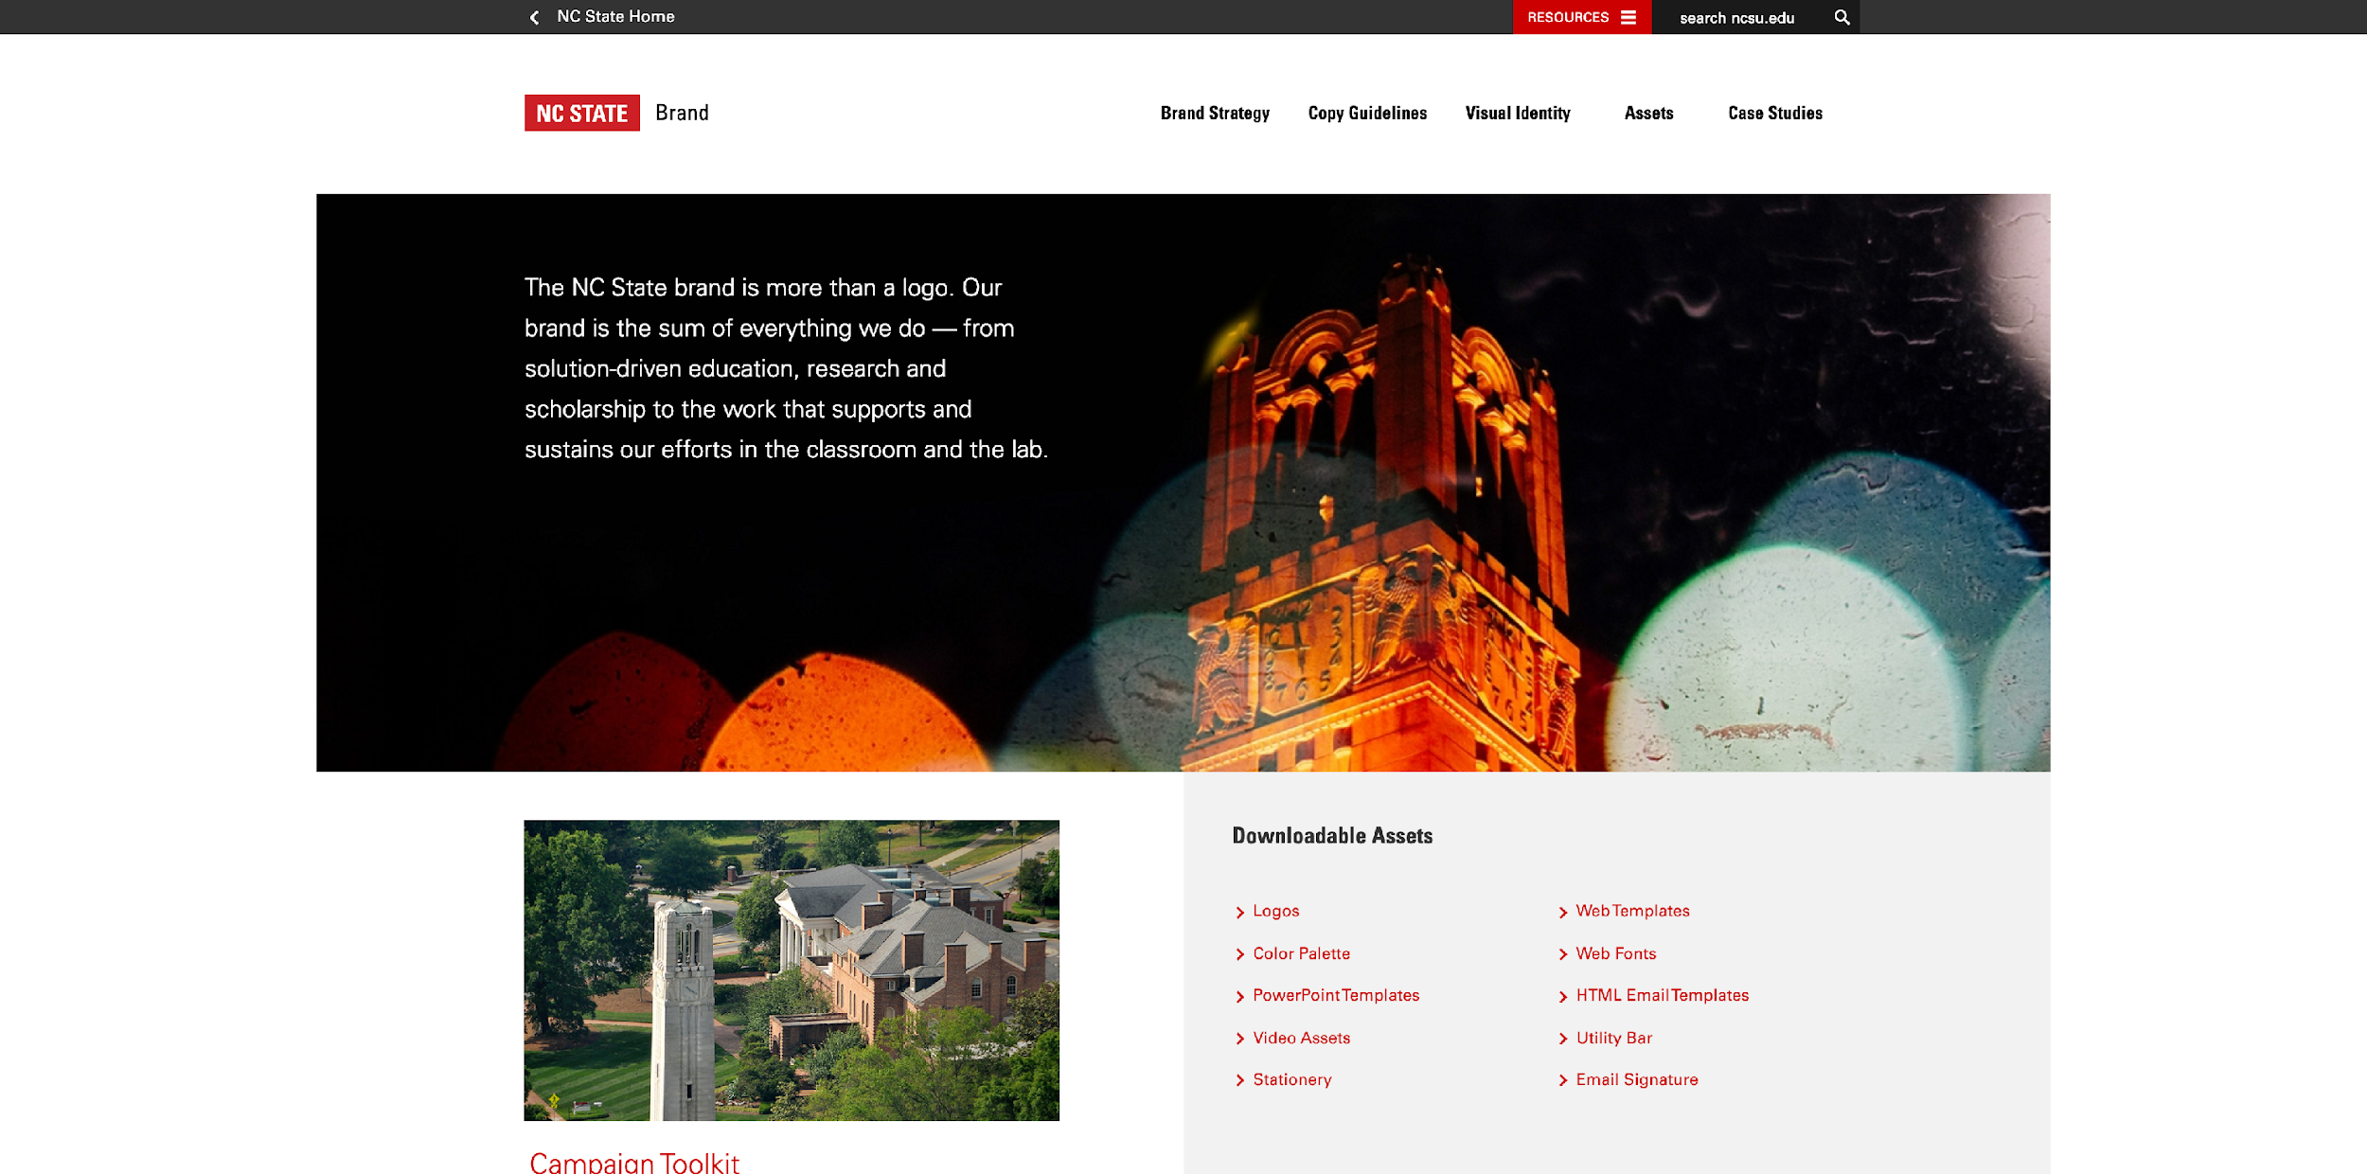

Slide 8
Voice

Slide 9
Voice
Reflects the institution’s “personality”

Slide 10
Brand Personality
A set of human personality traits associated with the NC State brand

Slide 11
Brand Personality
A set of human personality traits associated with the NC State brand
Courageous
Innovative
Intellectual
Purposeful

Slide 12
Voice
Reflects the institution’s “personality”
Distinguishes you from other institutions

Slide 13
Voice
Reflects the institution’s “personality”
Distinguishes you from other institutions
Relatively stable over time

Slide 14
Tone

Slide 15
Tone
Reveals your attitude toward the topic and/or the reader

Slide 16
Tone
Reveals your attitude toward the topic and/or the reader
Examples of tones a piece could have:

Slide 17
Tone
Reveals your attitude toward the topic and/or the reader
Examples of tones a piece could have:
Happy (exuberant, joyous)
Confident (authoritative, assured)
Sad (mournful, elegiac)
Compassionate (comforting, nurturing)

Slide 18
Tone
The same voice strikes different tones for different occasions:

Slide 19
Tone
The same voice strikes different tones for different occasions:
Fundraising letter to donors

Slide 20
Tone
The same voice strikes different tones for different occasions:
Fundraising letter to donors
In memoriam for deceased student

Slide 21
Tone
The same voice strikes different tones for different occasions:
Fundraising letter to donors
In memoriam for deceased student
Web copy touting positive economic impact

Slide 22
Tone
The same voice strikes different tones for different occasions:
Fundraising letter to donors
In memoriam for deceased student
Web copy touting positive economic impact
Magazine article about research innovations

Slide 23
Tone
The same voice strikes different tones for different occasions:
Fundraising letter to donors
In memoriam for deceased student
Web copy touting positive economic impact
Magazine article about research innovations
News story promoting upcoming arts event

Slide 24
Tone
The same voice strikes different tones for different occasions:
Fundraising letter to donors
In memoriam for deceased student
Web copy touting positive economic impact
Magazine article about research innovations
News story promoting upcoming arts event
Leadership response to campus crisis

Slide 25
Tone
Reveals your attitude toward the topic and/or the reader
Shaped to fit the specific occasion

Slide 26
Tone
Reveals your attitude toward the topic and/or the reader
Shaped to fit the specific occasion
Varies from piece to piece

Slide 27
Voice and Tone
Voice is who you are all the time.
Tone is how you feel right now.

Slide 28
Building Blocks of Voice and Tone

Slide 29
Building Blocks of Voice and Tone
Diction (word choice)

Slide 30
Building Blocks of Voice and Tone
Diction (word choice)
Plank vs. ?
Large vs. ?
Cheap vs. ?
Run vs. ?

Slide 31
Building Blocks of Voice and Tone
Diction (word choice)
Donor vs. ?
Discovery vs. ?
Leading vs. ?
Make vs. ?

Slide 32
Building Blocks of Voice and Tone
Diction (word choice)
We bring groundbreaking innovations to the marketplace.

Slide 33
Building Blocks of Voice and Tone
Diction (word choice)
We bring groundbreaking innovations to the marketplace.
We push groundbreaking innovations to the marketplace.

Slide 34
Building Blocks of Voice and Tone
Diction (word choice)
We bring groundbreaking innovations to the marketplace.
We push groundbreaking innovations to the marketplace.
We drive groundbreaking innovations to the marketplace.

Slide 35
Building Blocks of Voice and Tone
Sentence complexity/length

Slide 36
Building Blocks of Voice and Tone
Sentence complexity/length
NC State is a preeminent university.

Slide 37
Building Blocks of Voice and Tone
Sentence complexity/length
NC State is a preeminent university.
NC State is a preeminent public research university.

Slide 38
Building Blocks of Voice and Tone
Sentence complexity/length
NC State is a preeminent university.
NC State is a preeminent public research university.
NC State is a preeminent public research university with 10 colleges comprising all major academic fields.

Slide 39
Building Blocks of Voice and Tone
Sentence complexity/length
NC State is a preeminent public research university with 10 colleges comprising all major academic fields and a cooperative extension service that provides evidence-based assistance to citizens in all 100 North Carolina counties and the Eastern Band of Cherokee Indians.

Slide 40
Building Blocks of Voice and Tone
Syntax (word arrangement)

Slide 41
Building Blocks of Voice and Tone
Syntax (word arrangement)
Whatever comes at the end of a sentence is emphasized.

Slide 42
Building Blocks of Voice and Tone
Syntax (word arrangement)
Whatever comes at the end of a sentence is emphasized.
Farmers turn to NC State when they need help responding to the effects of climate change.

Slide 43
Building Blocks of Voice and Tone
Syntax (word arrangement)
Whatever comes at the end of a sentence is emphasized.
Farmers turn to NC State when they need help responding to the effects of climate change.
When farmers need help responding to the effects of climate change, they turn to NC State.

Slide 44
How to Use a Strategic Voice and Tone

Slide 45
How to Use a Strategic Voice and Tone
Let brand personality determine the voice.

Slide 46
How to Use a Strategic Voice and Tone
Let brand personality determine the voice.
Let the occasion determine the tone.

Slide 47
How to Use a Strategic Voice and Tone
Let brand personality determine the voice.
Let the occasion determine the tone.
Create the voice and shape the tone through diction, sentence complexity/length and syntax.

Slide 48
Strunk and White's Rule No. 17
“Vigorous writing is concise. A sentence should contain no unnecessary words, a paragraph no unnecessary sentences, for the same reason that a drawing should have no unnecessary lines and a machine no unnecessary parts. This requires not that the writer make all his sentences short, or that he avoid all detail and treat his subjects only in outline, but that every word tell. Many expressions in common use violate this principle.”
— William Strunk Jr. and E.B. White, The Elements of Style

Slide 49
Brent Winter bhwinter@ncsu.edu

