Slide 1
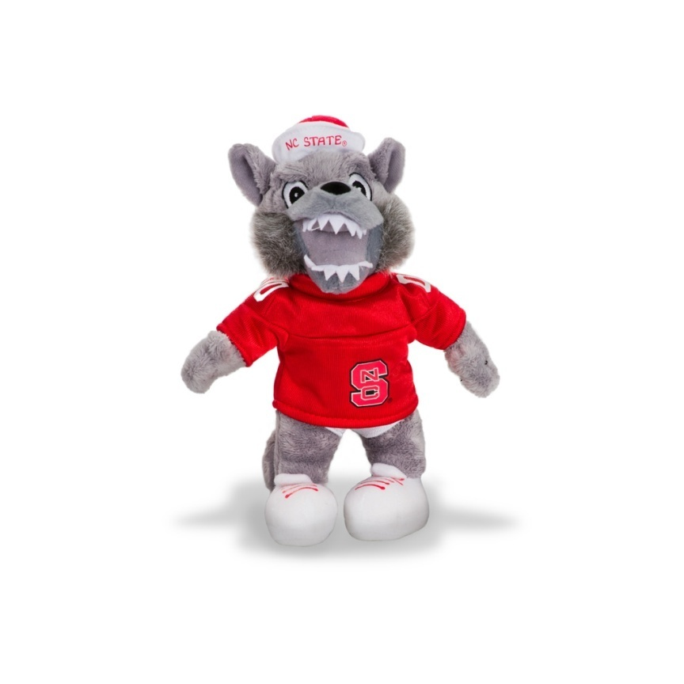
Your Name Here
Anytown, State
I would like to thank Papa Wolf and Momma Wolf, my Wolfpack instructors and friends. I did it!
GO PACK!!
To find a job where I can showcase my skills to the fullest!

