Slide 1
Adapting Agriculture to a Changing Climate:
Past and Present
Dr. Eric Edwards
Dept. of Ag and Resource Economics
Franklin County Grain Meeting
February 20, 2020

Slide 2
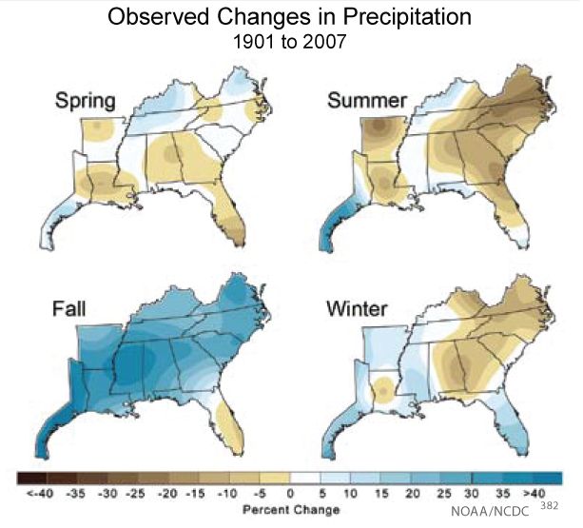
Climate Change, Past
Large climate shifts since 1900
Precipitation in Southeast has increased by about 30%
Parts of NC, however, have seen 30% decreases in summertime precipitation
Notes:
Today I want to discuss the relationship between agricultural production, land values and future climate change. Then we’ll get into the role of water. Climate change is a politically charged term, so I want to be clear that I’m talking about climate change in the sense of changing patterns of weather over time, not climate policy, Green New Deal, carbon emissions, etc. I want to talk about what scientists are predicting might happen to climate over the next 60 years and how that might affect agricultural output, profitability, and land values. And, what can maybe be done about it in terms of adaptation. Why adaptation? Because farmers are always adapting and changing and oftentimes the science doesn’t properly account for this, which I’ll talk about momentarily. First, however, I want to draw your attention to climate change, 1900 to today.

Slide 3
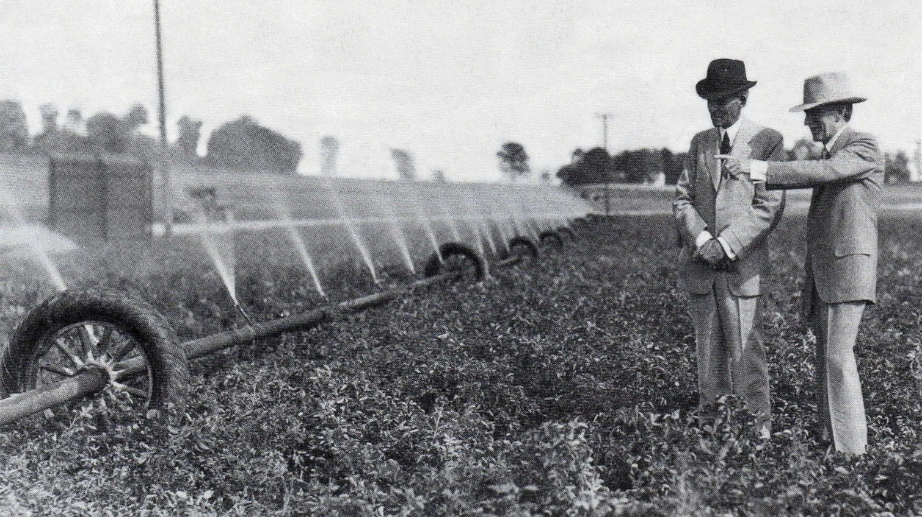
Adaptation to Climate: Water Management
Drainage
Irrigation

Slide 4
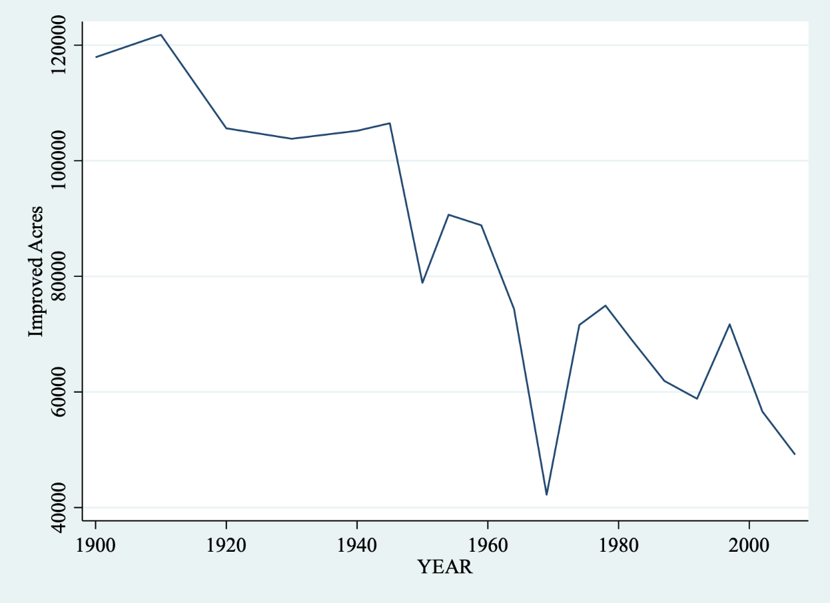
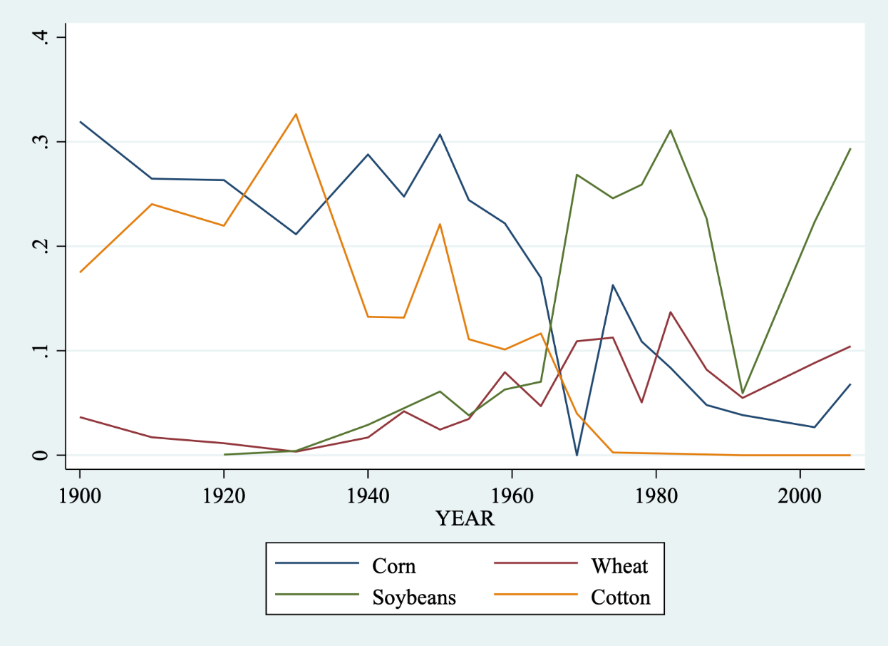
Crop Choices in Franklin County, NC

Slide 5
Drainage
Drained Lands in North Carolina 1940
Drain tile first used in New York State in 1838
Adoption quickly spread across upper Midwest starting 1850s
North Carolina adopts a drainage act in 1909
1960s: corrugated plastic tubing and laser controlled trenchers.
Today: 40 percent of NC cropland requires drainage improvements
Notes:
Already around 40% of cropland has drainage and 5% irrigation. But, potential to do more is possible. Irrigation has been gaining traction in North Carolina. About 10% of farms are irrigated as of 2012.
Mattamuskeet Drainage Company
Ake Wheeler Road NC State extension Research Facilities

Slide 6
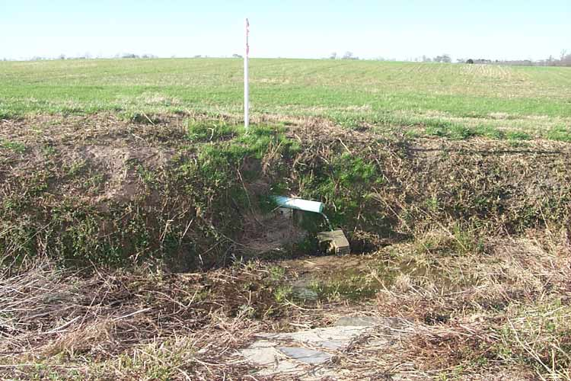
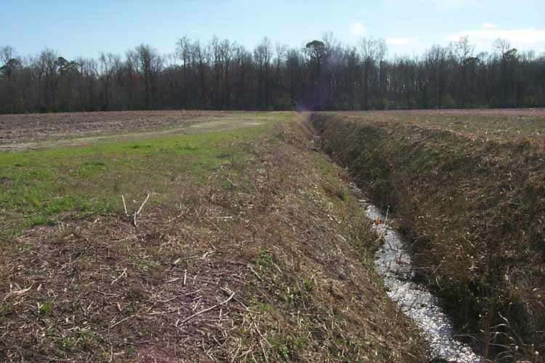
Types of Drainage
Drain Tiles
Drainage Ditches
Notes:
Drainage can be improved by installing ditches or drain tiles as shown in the pictures. When water falls on a field and percolates into the groundwater system, a low outlet, either buried like drain tile or open like a ditch, allows the water to flow underground off the land.

Slide 7
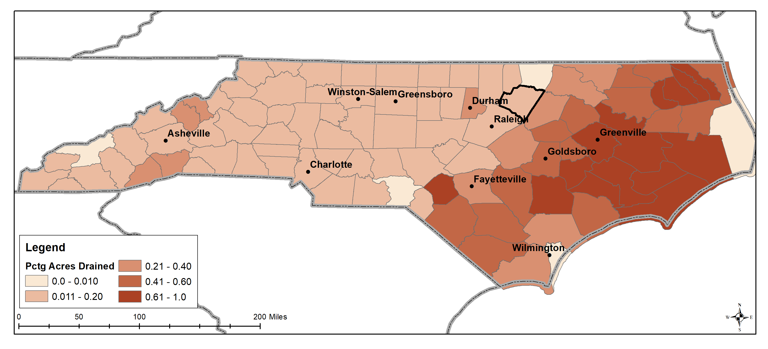
Percentage of Crop Acres Drained
Data source: USDA Ag Census Quick Stats
Notes:
The eastern part of the state is especially low and wet, making drainage an important adaptation.
Agricultural water management (water table management) for enhancing crop yield and reducing the negative water quality impacts of crop production on artificially drained agricultural landscapes using controlled drainage and sub-irrigation systems.

Slide 8
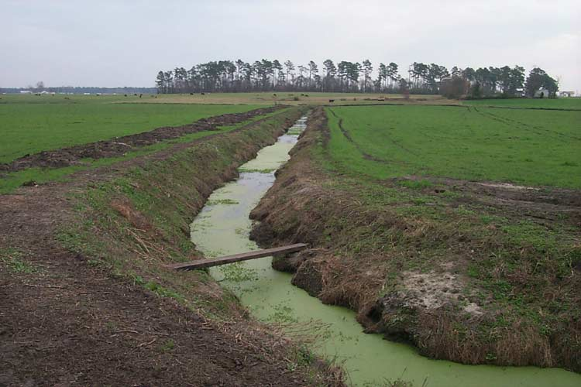
Drainage Issues
Farm drainage also drains nutrients
  Nitrogen and phosphorous
Drainage takes lands out of wetland habitat
  53% reduction from 1780 to 1992
Smart systems
  Avoid draining right before a drought
  Apply fewer nutrients
  Absorb nutrient runoff

Slide 9
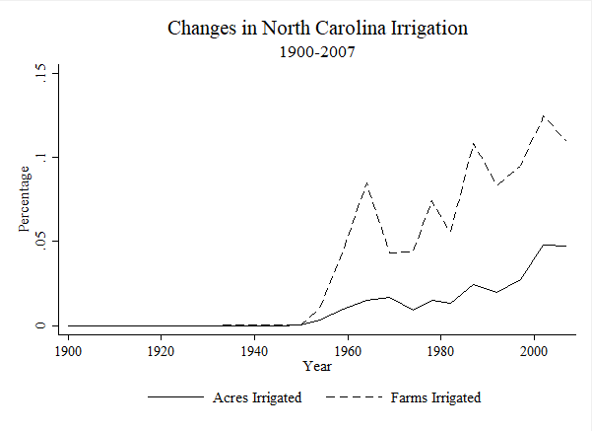
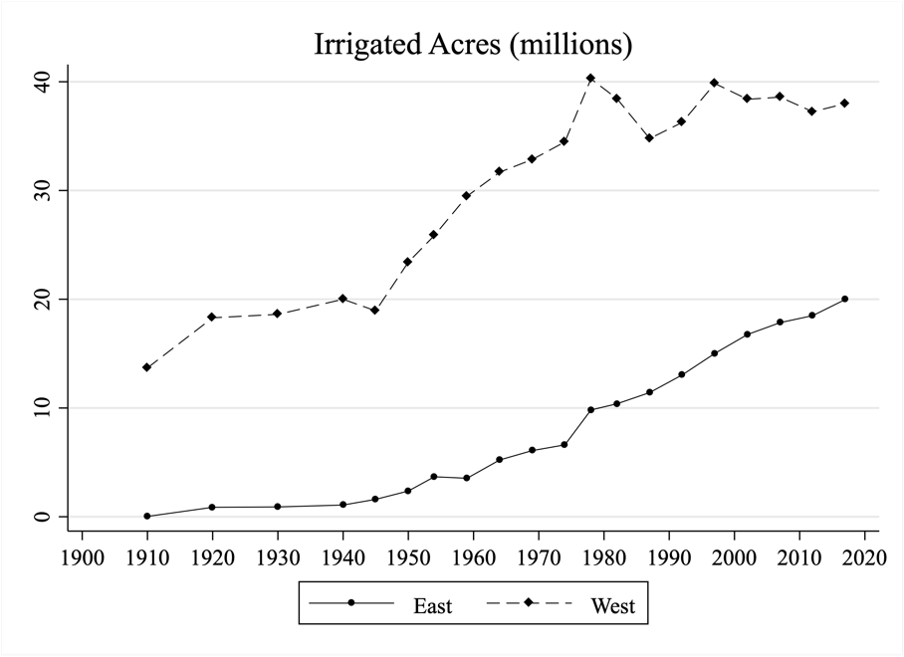
Irrigation
North Carolina: about 5% of acreage and 10% of farms are irrigated
US: Nearly all new growth in irrigated acres is occurring east of Mississippi
Notes:
Already around 40% of cropland has drainage and 5% irrigation. But, potential to do more is possible. Irrigation has been gaining traction in North Carolina. About 10% of farms are irrigated as of 2012.
Mattamuskeet Drainage Company
Lake Wheeler Road NC State Extension Research Facilities

Slide 10
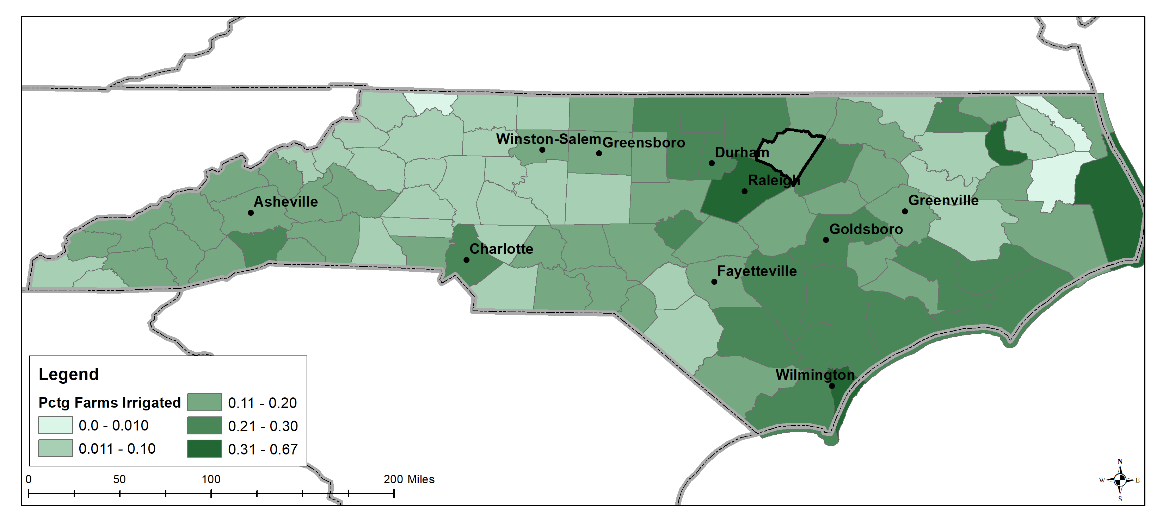
Percentage of Farms with Irrigation
Data source: USDA Ag Census Quick Stats
Notes:
North Carolina doesn’t need irrigation to grow crops, but it can provide important water source during periodic times when rainfall is low.

Slide 11
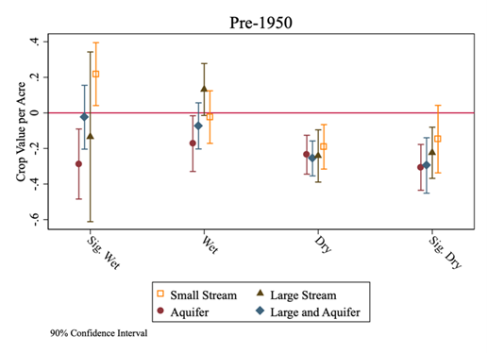
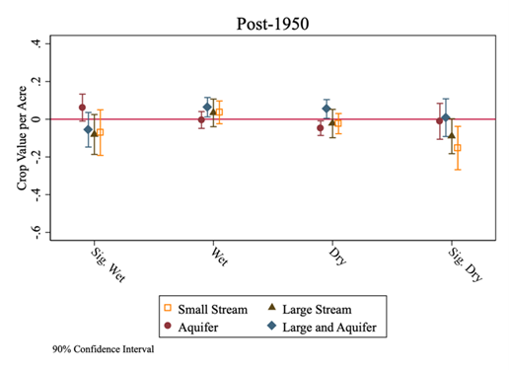
Western US: Water Storage and Crop Value

Slide 12
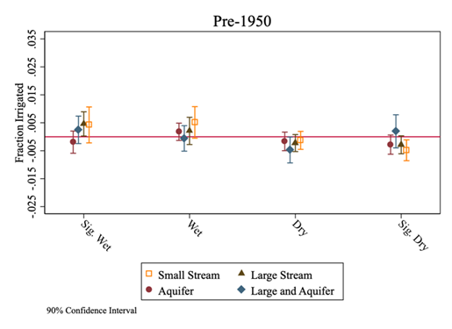
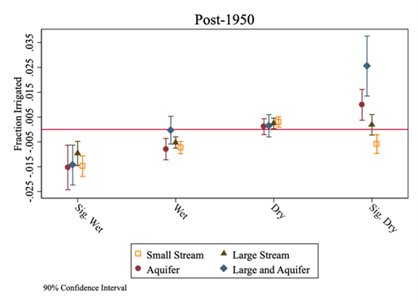
Western US: Water Storage and Acres Planted

Slide 13
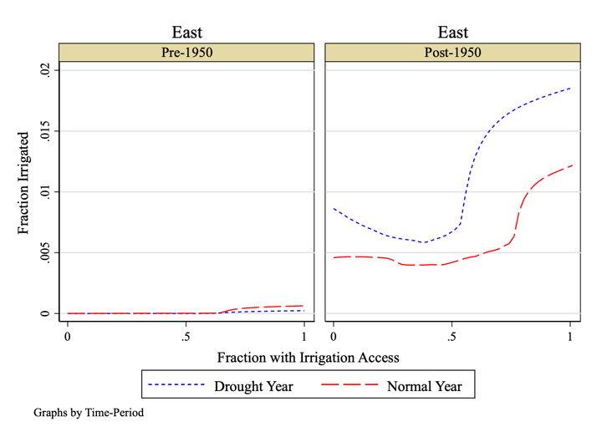
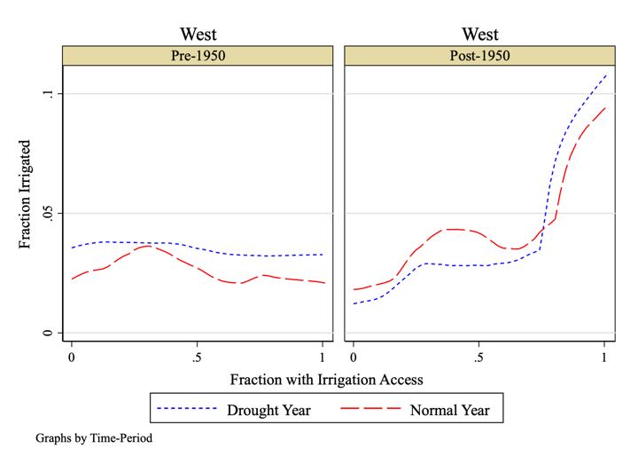
Access to Water and Drought Response
US East of 98th Meridian
US West of 98th Meridian

Slide 14
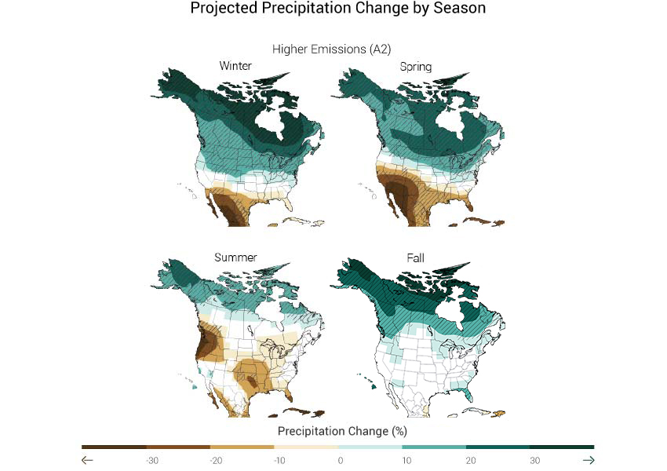
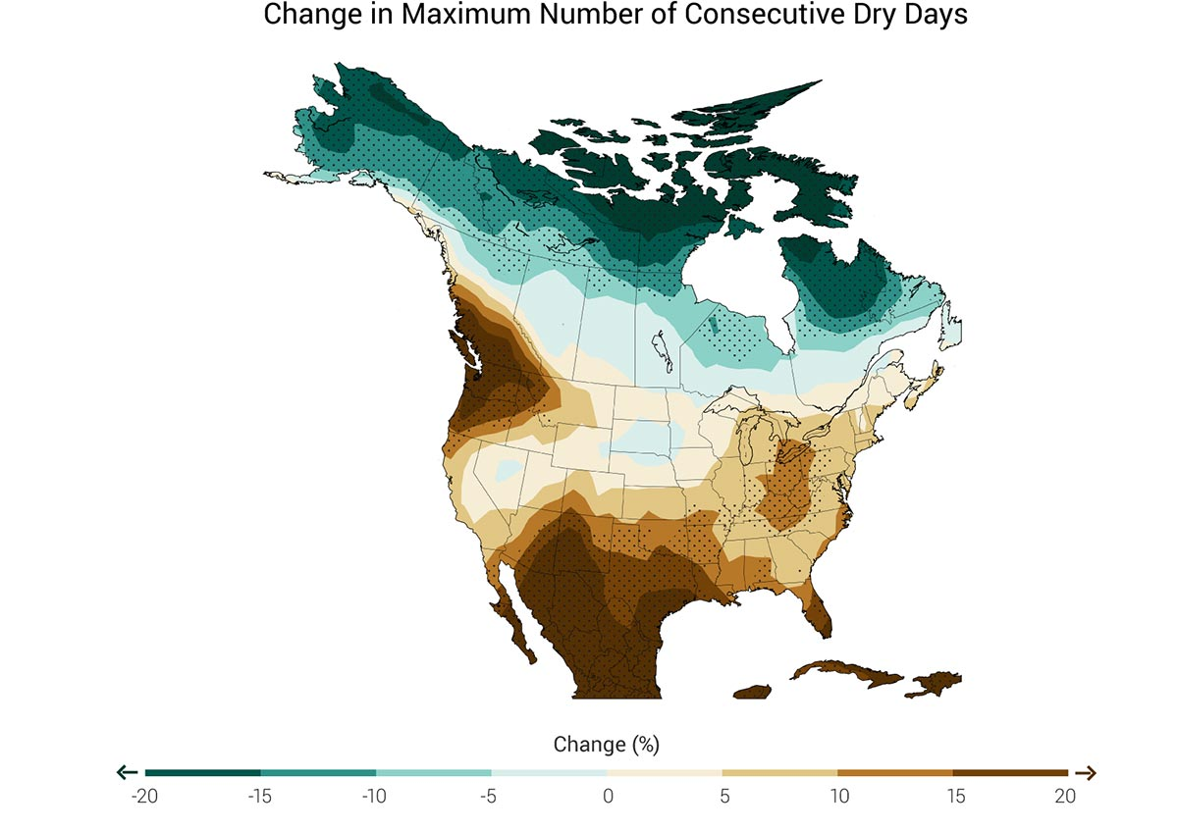
Climate Change, Present and Future
Source: National Climate Assessment with data from NOAA NCDC / CICS-NC
Notes:
Scientists project the effect of climate using complex models that require massive computing power and a lot of assumptions. Generally, I don’t trust the reliability of any one model very much. The map depicts the average warming at each location
associated with a 1°C increase in global mean temperature; values greater than 1°C indicate rates of warming faster than the global mean, while values below 1°C indicate warming that is slower than the global mean. NC is right near that average.
This model isn’t going to be “right,” but it gives you a middle-of-the-road idea of what climate change wil llook like, and the consensus is for North Carolina that will be warmer and wetter, but with potentially more periods without precipitationin the summers.

Slide 15
Climate and Agriculture
Plant response to climate is affected by:
  Carbon dioxide (CO2)
  Temperature
  Solar radiation
  Precipitation
Timing of changes is important
  Temperature during pollination stage
Notes:
So, what’s the potential effect of climate change? Plants respond to many factors that a changing climate and. Climate change is caused by elevated CO2, which also helps plants grow. Climate change will raise temperatures, which can help or hurt plant growth, and affects yields in non-linear ways. Temperature increase are energy increases, and the additional energy creates more ocean activity and evaporation. North Carolina is expected to get wetter and warmer. The additional energy in the system is expected to general more hurricanes and other large precipitation events. Additional moisture in the air also affects the amount of cloud cover, and thus solar radiation hitting plants.
Climate changes tells us something about how the weather will change, e.g. it will be hotter, wetter, etc. But the variation in weather over the day and year is also important. Crop yields are more susceptible to temperature and precipitation extremes at certain times. For instance, hot-temperature extreme weather events have a large effect on corn during the pollination stage.
Water can mitigate temperature effects. Misting apple orchards, for instance, can cool the trees enough during very hot spells to protect yields. However, water can also be the problem. Extreme events can inundate fields with water. But even heavier than normal precipitation can leave water tables too high for optimal crop growth.

Slide 16
Crops: Big-4 / Climate Relationship
Source: Hsiang, S., Kopp, R., Jina, A., Rising, J., Delgado, M., Mohan, S., Rasmussen, D.J., Muir-Wood, R., Wilson, P., Oppenheimer, M. and Larsen, K., 2017. Estimating economic damage from climate change in the United States. Science, 356(6345), pp.1362-1369.
Notes:
How to translate projections of changes in precipitation and temperature to changes in crop output? In heir recent paper in science, Hsiang et al (2017) generate crop-yield to weather variable relationships. The yields are generally non-linear, meaning it’s not a straight line. Generally, it’s hard to grow something at 0 degrees but gets better as the temperature increases, until a point where it is too hot for the plant. The functions show yields as a function of seasonal rainfall and seasonal 24-hour temperatures. You can interpret log yields as percentages. A one degree temperature increase at some point on the chart leads to the blue line x100 percentage decrease in yield. For instance, increasing temperature from 29 to 30 degrees C for cotton increases yields by about 2%, but increasing temperature from 39 to 40 degrees C decreases yields by almost 3%.
Cotton—fairly heat tolerant
Soybeans—huge drop in yield with high heat

Slide 17
US Temperature Change Projections
Source: Hsiang, S. and Kopp, R.E., 2018. An Economist's Guide to Climate Change Science. Journal of Economic Perspectives, 32(4), pp.3-32.
Notes:
This chart shows how summer (growing season, typically) temperatures will change by 2080-2099. Summer temperatures in North Carolina by 2080 will be higher than those in Louisiana or Texas today in a high emissions scenario. Finding these types of projections for each county in the US is difficult and requires a lot of assumptions, it also leads to a lot of uncertainty. However, this doesn’t mean that temperatures won’t get hotter. It just means we’re unsure how much hotter. Given these temperatures and out yield functions, we can calculate changes in crop production as a result of climate change.

Slide 18
US Temperature Change Projections
Source: Hsiang, S. and Kopp, R.E., 2018. An Economist's Guide to Climate Change Science. Journal of Economic Perspectives, 32(4), pp.3-32.
Notes:
This chart shows how summer (growing season, typically) temperatures will change by 2080-2099. Summer temperatures in North Carolina by 2080 will be higher than those in Louisiana or Texas today in a high emissions scenario. Finding these types of projections for each county in the US is difficult and requires a lot of assumptions, it also leads to a lot of uncertainty. However, this doesn’t mean that temperatures won’t get hotter. It just means we’re unsure how much hotter. Given these temperatures and out yield functions, we can calculate changes in crop production as a result of climate change.

Slide 19
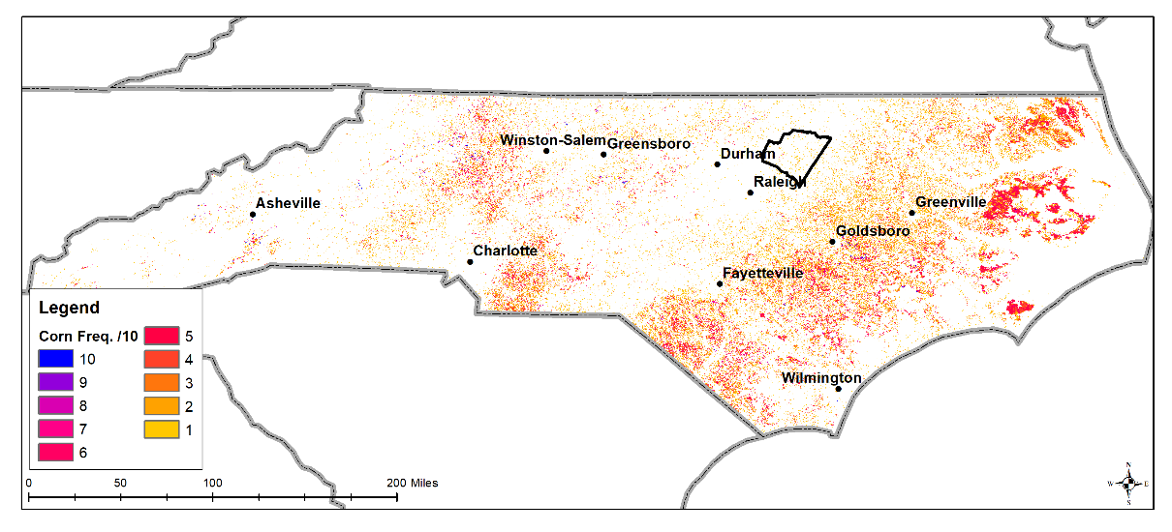
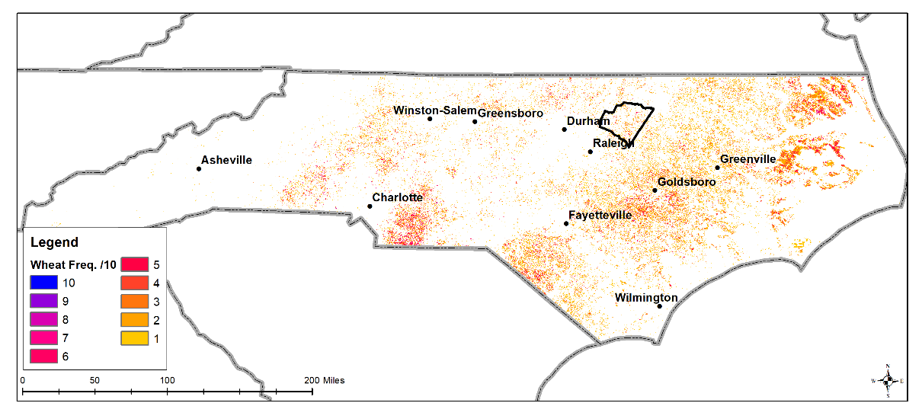
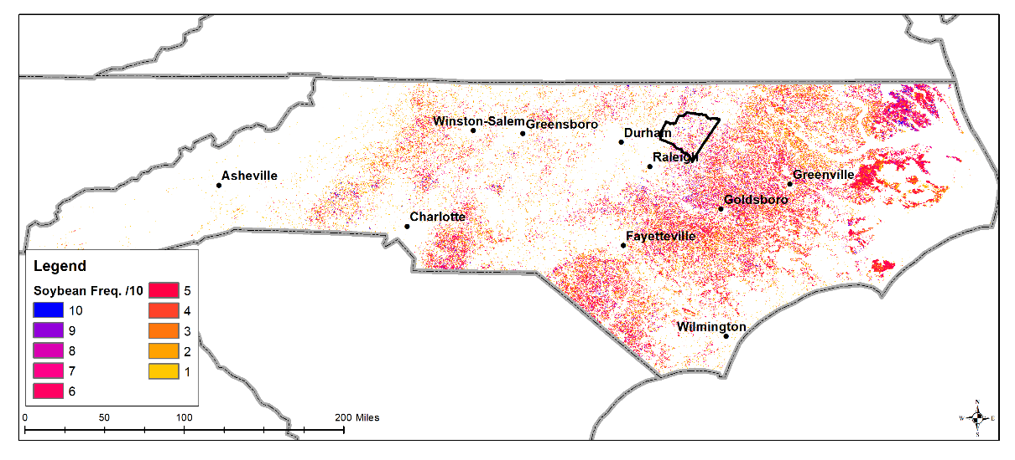
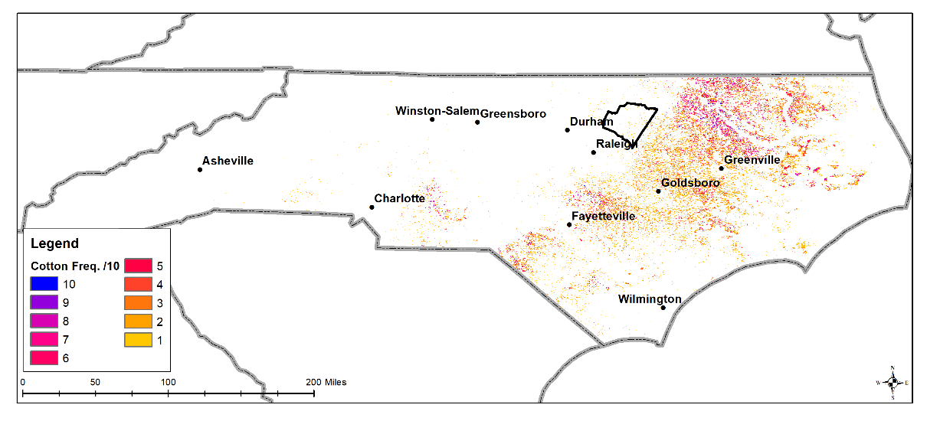
10-year Crop Frequencies
Corn
Wheat
Soybeans
Cotton
Data source: CropScape - Cropland Data Layer. National Agricultural Statistics Service
Notes:
Here’s what happening in NC with ht ebig-4 crops right now. We plot the frequency of plantings for each type of crop over the last 10 years. Dark blue means the crop was planted every year. Yellow means it was planted once in the last 10 years. There is so much to unpack here, we’re just going to focus on a few key trends. First, the NC cotton belt in the northern portion of the state, these counties are going to see climate impacts from changes in cotton yields. AS you’ll recall, cotton is fairly heat tolerant. Second, lots of soybeans on the coastal plain. You’ll recall soybeans had the highest negative yield response to high temperatures. Third, crop rotations. This implies farmers have some flexibility in what they plant—we’ll get back to this. Finally, fourth, is the distribution of sales. The western part of the state doesn’t grow much. You’ll recall ag land was valuable in the west, but in aggregate there isn’t much of it.

Slide 20
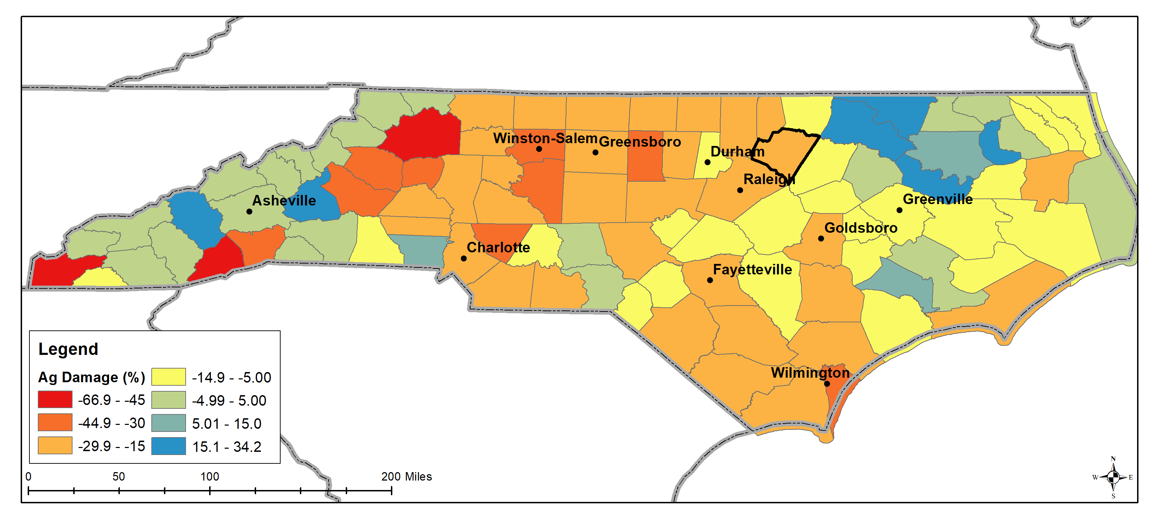
Big-4 Crop Yield Projections (2080-2099)
Data source: Hsiang et al (2017)
Notes:
Taking htos yield functions and climate change projections to North Carolina counties, we arrive at this map of potential percentage losses. There is quite a range. Some counties expect yields an revenues to increase, others see losses over 40%. Note the cotton counties are blue and green, but much of the rest of the state faces losses. The large western losses are in percentage terms, but…

Slide 21
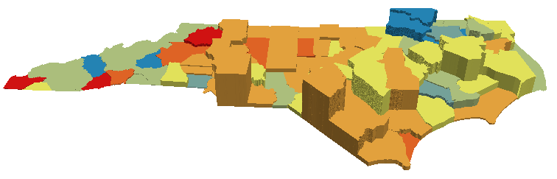
Damage Projections with Current Sales (Big 4)
Data sources: USDA Ag Census Quick Stats and Hsiang et al (2017)
Notes:
When you plot the actual amount of sales as the county elevations, you see that the largest percentage losses are not large total sales losses. Instead, losses in sales are predicted to hit Orange: Union and Robeson. As well as the coastal plain growers who are not in cotton. Yellow (group 1): Sampson, Duplin, Wayne, Lenoir; Yellow (group 2): Beaufort, Pitt, Hyde, Washington. Benefitting the most in terms of sales are Green: Bertie, Halifax, Edgecomb, Northhampton.

Slide 22
Caveats
Only Big-4 Crops
  What about livestock?
  What about specialty crops?
    Sweet potatoes
    Tree crops
    Peanuts
Assumes similar crop choice mix going forward
  Change crops
  Water management
    Irrigation when dry, drainage when wet
    High-precipitation events
Notes:
Livestock – not included; generally do less well in heat, but not a county-level analysis yet.
Specialty crops – very valuable, typically more sensitive to temperature and precipitation—thus why we see pockets of these crops.
Big caveat is that the approach necessarily assumes a static allocation of crops.
Other investments in mitigation are possible, in particular farmers can do more to keep fields dry (drainage) and wet (irrigation)

Slide 23
Thank you!
Questions?

