Slide 1
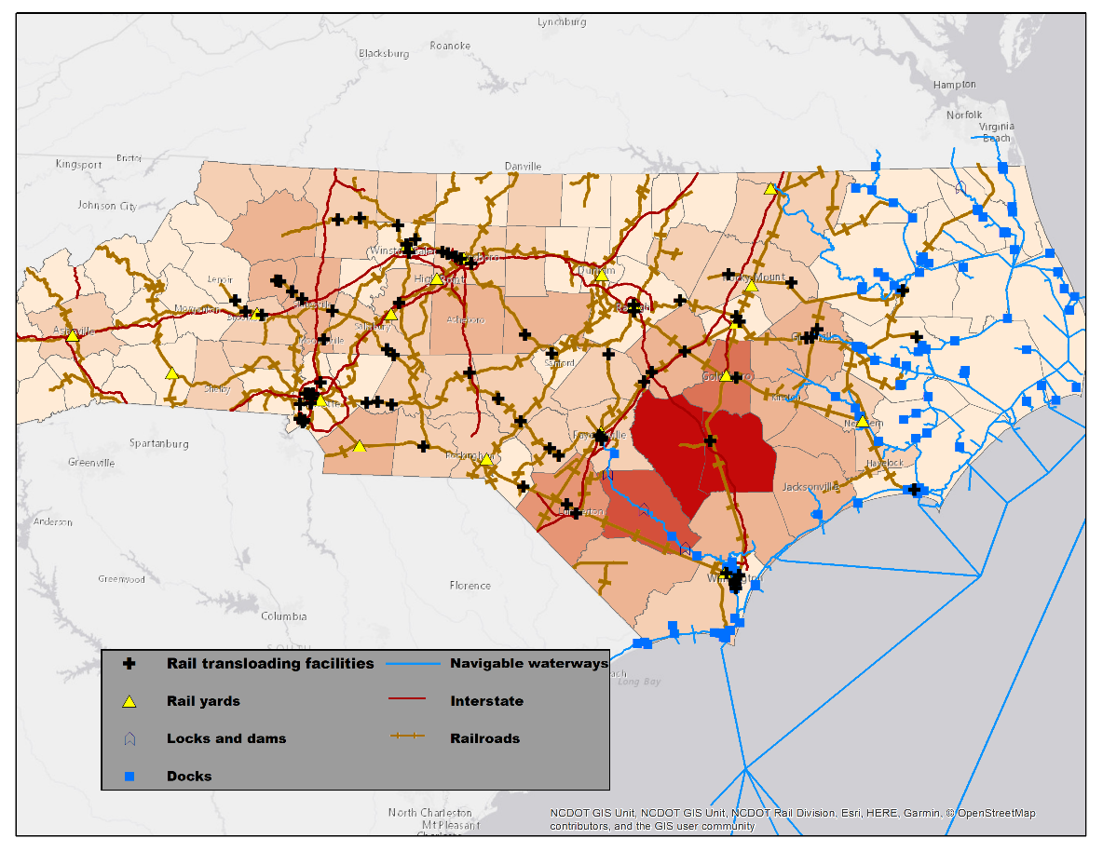
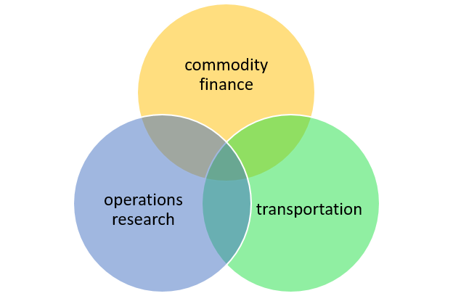
Grain Production, Transportation, and Supply Chain Management
Heidi Schweizer
email: hschwei@ncsu.edu
twitter: @heidipschweizer
Infrastructure: road maintenance, dredging
Transportation policy: ELD mandate
Technology: blockchain, self-driving trucks

