Slide 1
US and NC Outlook for Corn, Soybeans, and Wheat
Nick Piggott
Dept of Agricultural & Resource Economics
North Carolina State University
Email: nick_piggott@ncsu.edu
Presentation:
2018 Extension State Conference November 14, 2018
Raleigh, NC

Slide 2
2018F U.S. agricultural economy setting new lower levels from historical highs

Slide 3
US agriculture is now experiencing a cost-price squeeze--a period of increasing costs and simultaneous decreasing prices.

Slide 4
Trade Wars Implications for Agriculture
In March 2018, U.S. imposes tariffs to protect U.S. manufacturing jobs (25% tariff on steel and 10% on aluminum)
The response from the rest of the world has been tit-for-tat tariff increases on U.S. exports. A focus has been on the retaliation tariffs from China.
U.S. agriculture in the spotlight for tariff retaliation
China has threatened to impose a 25% tariff on 128 U.S. products in response to a U.S. proposal to impose a 25% tariff on imported products from China
The Chinese list includes soybeans, wheat, corn, sorghum, and beef.
Soybeans is the largest agricultural export from the United States to China.
US soybean exports account for approximately 48% of total use annually. More than 60% of these exports are destined to China so the Chinese tariff on U.S. soybeans alone could generate major economic consequences for U.S. agriculture.
China also imports significant quantities of wheat, sorghum, and corn from the United States. Extending the coverage of Chinese tariffs on these products could amplify the economic implications of China’s retaliation policy for U.S. agriculture.

Slide 6
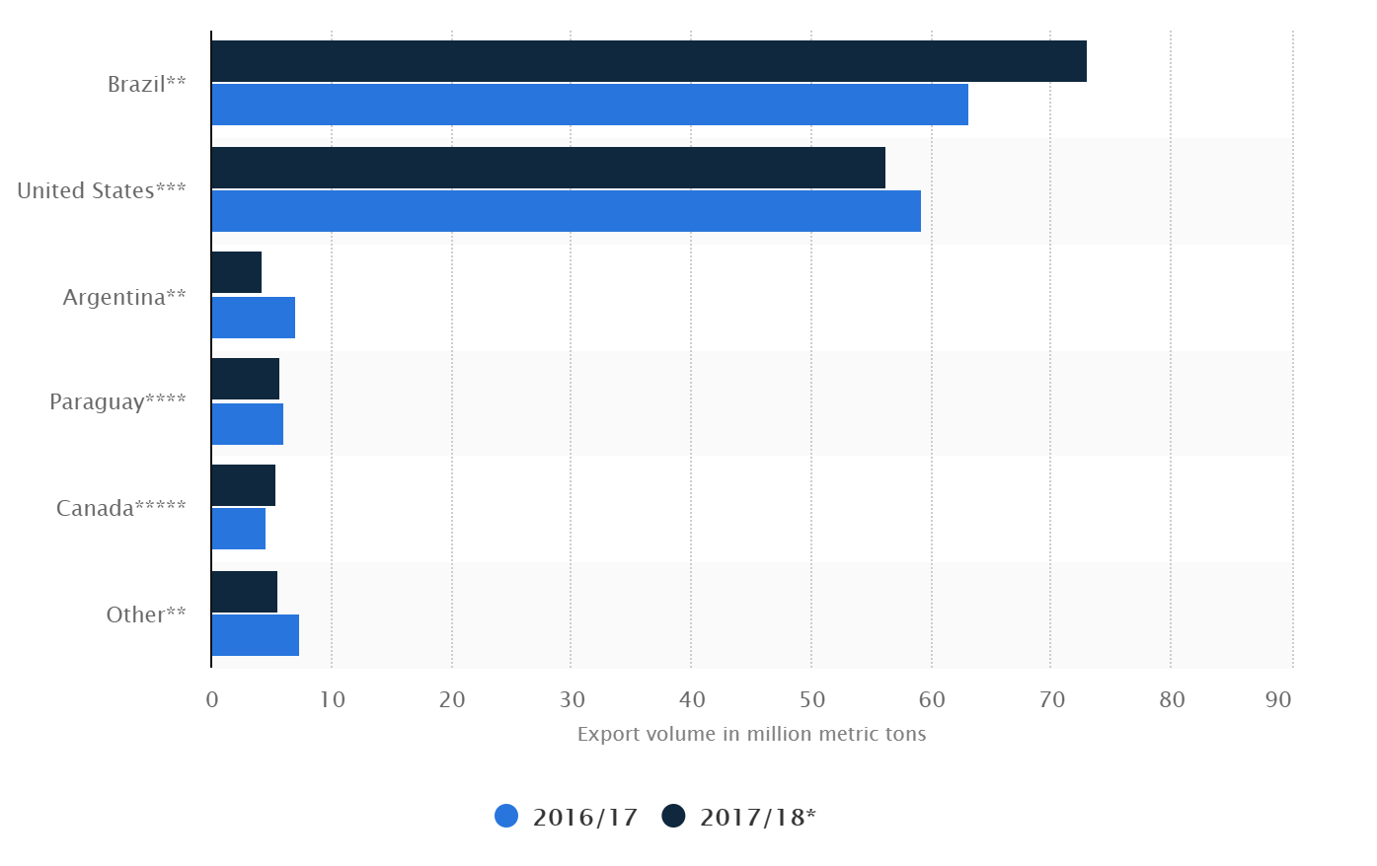
Soybean Export Volume by Country

Slide 7
What is a Tariff? Why Use Them?
A tariff is a tax levied on an imported good. There are two types:
A per unit tariff is a fixed charge for each unit—$90 per metric ton of imported soybeans
A proportion tariff (“ad valorem”) is levied as a proportion of the value of imports—25% tariff on imported soybeans
Why do countries impose tariffs?
To raise revenues—more prominent historically
To alter the balance of trade. Tariffs make imports more expensive.
To protect and develop infant industries
To protect domestic employment from more competitive foreign products
Retaliation when a country thinks a trading partner has not played by the rules

Slide 8
Tariffs: Winners and Losers
Beneficiaries:
Governments receive increased revenues
Producers and workers in domestic industries enjoy reduced competition (inflated prices)
Losers:
Domestic consumers—individuals and businesses because of higher priced goods.
Domestic exporters who experience retaliatory tariffs
Economic welfare—there are deadweight losses from tariffs in the form of production and consumption efficiencies

Slide 10
NC Major Row Crop Acreage: 2008-2018
Past 11 years reveals, over the pre- and post- feed grain initiative, a decline in total acres of 10.7%, with a decline in feed grain acres (19%).
Corn acres have slightly increased 3.3%
Wheat acreage has declined by 43.5% but this masks a significant run-up between 2010 and 2013 when wheat acres more than doubled but then significantly declined back to 2010 levels by 2017. Projections for 2018 show slight increase.
Sorghum acreage increased by 25% this also masks that acreage spiked to 70K and 80K in 2012 and 2013 in the initial two years of the feed grain initiative
Feed grain acres projected to increase by 5.1% in 2017 over 2018 levels
Copyright © Nick Piggott

Slide 13
Feeding the “Tails and Feathers”
There are three primary sources of procuring feed grains to feed the “tails and feathers:
Midwestern feed grains via rail was the traditional source and mode
Local feed grain production primarily corn, some winter wheat (about 80% is fed), and small amounts of sorghum via truck to various fed mills
Internationally, primarily South American and sometimes European feed grains via the Port of Wilmington
In July 2002, Wilmington Bulk LLC opened an import-export grain terminal in Wilmington, NC

Slide 14
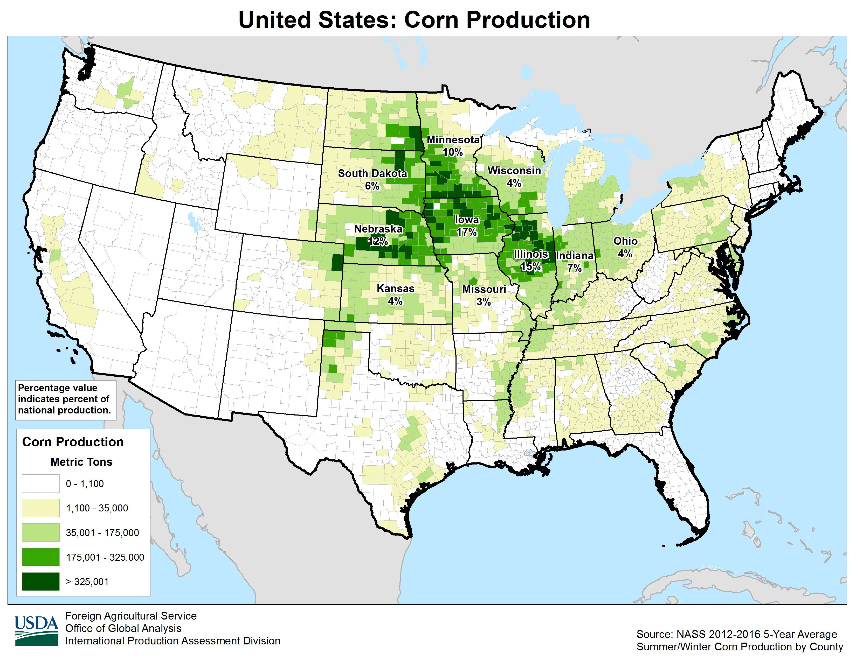
Corn Production in US

Slide 15
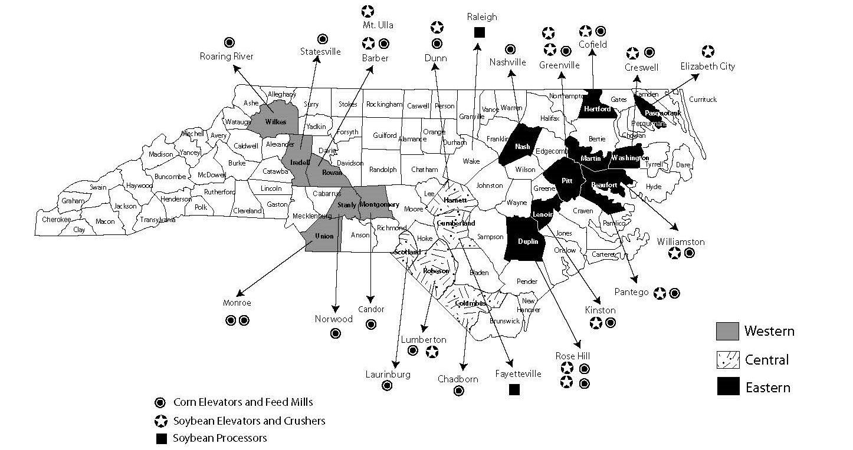
North Carolina Feed Grain Markets

Slide 16
Feed Grain Deficit Around 50%

Slide 21
Corn Futures C-Dec18
Market losses $0.80/bu
Market trading sideways $3.50/bu-$3.90/bu
Lower resistance around $3.50/bu Mid July

Slide 22
Corn Futures C-Dec19
Market trading sideways in a $0.26 band--$3.86/bu-$4.12/bu about $0.36/bu more than C-Dec19

Slide 27
Soybean Futures S-Nov18
Market losses $1.20/bu
Market gain $0.80/bu
Market trading sideways $8.40/bu-$8.80/bu
Lower resistance around $8.40/bu Mid July

Slide 28
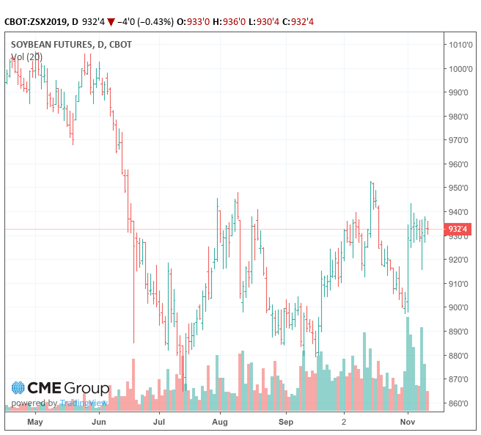
Soybean Futures S-Nov19
Market trading sideways $8.80/bu-$9.50/bu—about $0.40/bu more than S-Nov18

Slide 33
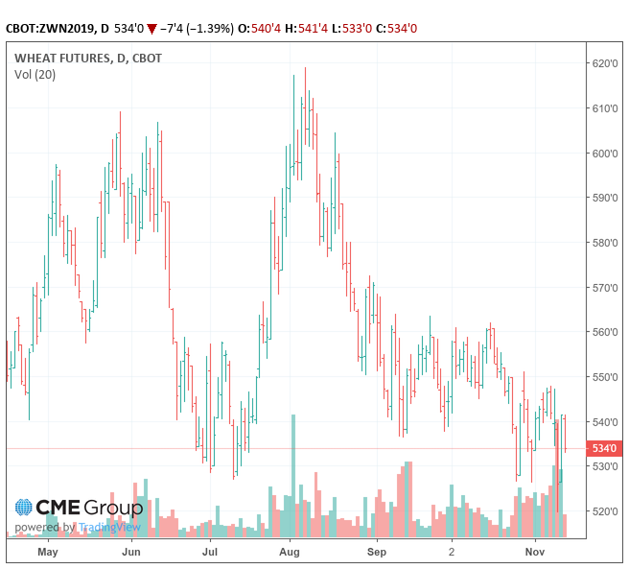
Wheat Futures W-Jul19
New crop winter wheat has given back $0.90/bu recently—discouraging planting. Market must strengthen to bid acres

Slide 34
Final Thoughts
Tariffs are trade distorting. Farmers are better off with trade not aid. Retaliator tariffs can be lose-lose as trade relationships that take years to establish can be decimated and are hard to rebuild.
Lost agricultural exports to China will mostly be rerouted to other destinations limiting export impacts. World demand has not declined.
Recent announcement of $12 billion aid package to offset tariffs is a short-term fix. Returning to free trade is a long term fix.
Cost-price squeeze is impacting US agricultural economy
Current and new crop futures charts reveal corn, soybean, and wheat markets are general trading sideways. As we approach planting early next year, look for upside breakouts in Jan-Mar, as corn and soybeans bid for acres. The massive soybean endingstocks will weigh on soybean prices.

Slide 35
New Enterprise Budgets Posted
Current Budgets:

Slide 36
Planting Decision Tool

Slide 37
THANK YOU
QUESTIONS?

Slide 39
RECOMMENDED MARKETING STRATEGIES FOR DIFFERENT FUTURES PRICE AND BASIS RISK SITUATIONS
Strong Current Basis
Basis Contract
Cash Forward Contract
Low Current
Futures
Price
High Current
Futures
Price
Do Nothing Now
Buy Put Option
Futures Hedge or
Buy Put Option
Weak Current Basis

Slide 40
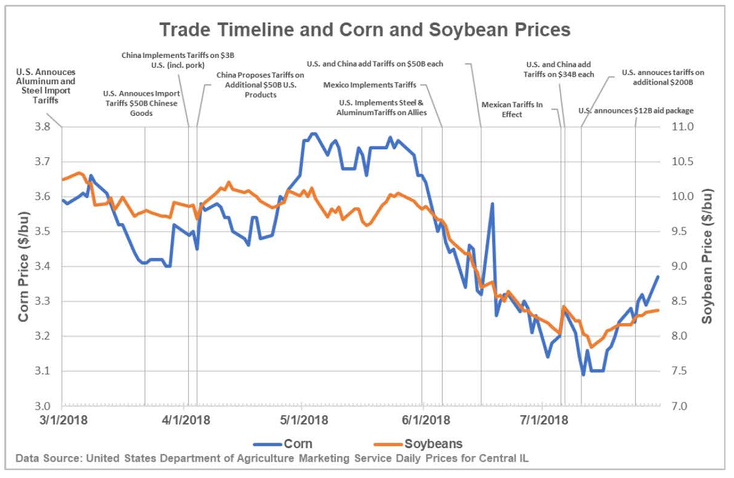
Timeline for Corn and Soybeans
Source: Swanson, K, J. Coppess, and G. Schnitkey. “Trade Timeline and Corn and Soybean Prices.” farmdoc daily (8): 141 , Department of Agricultural and Consumer Economics, University of Illinois at Urbana-Champaign, July 31, 2018.

Slide 41
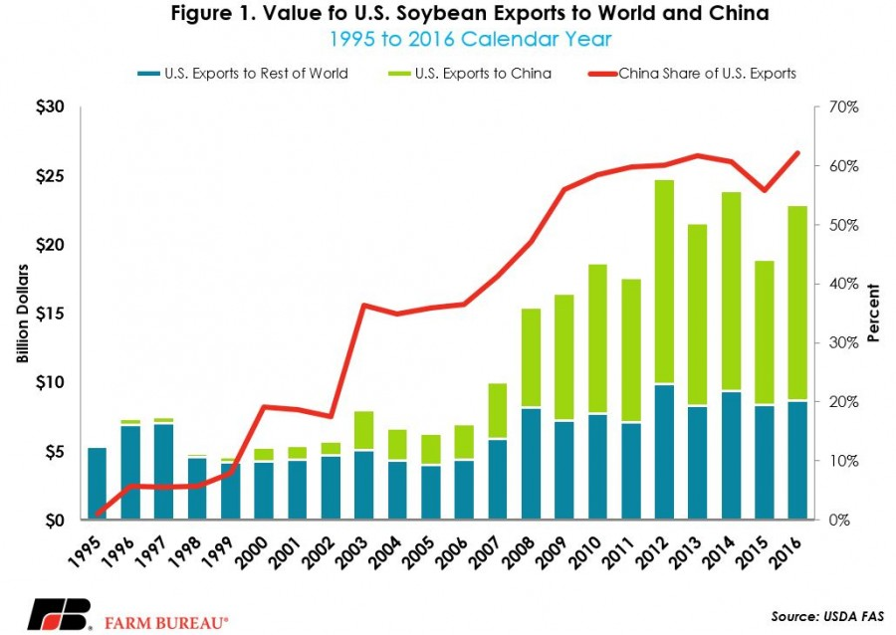

Slide 42
Price
Supply
Welfare Impact of a Tariff
P_{world}+T
1
T
2
3
4
P_{world}
Imports
Demand
Q_{D}
Imports
Q_{T}
Welfare Impacts
Domestic Producers= +1
Government= +3
Consumers= -(1+2+3+4)
Net Welfare= (1+3)- (1+2+3+4)
= -(2+ 4)
Q_{D}’
Q_{T}’
Tariff=(P_{world}+T) – P_{world} = T
Decline in Imports= (Q_{T}-Q_{D}) – (Q_{T}’-Q_{D}’) = (Q_{T}-Q_{T}’)+(Q_{D}’ - Q_{D})

