Slide 1
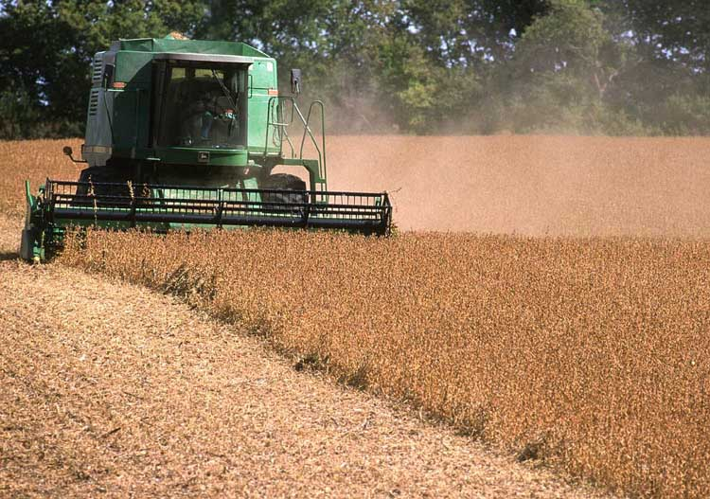
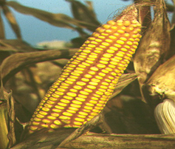
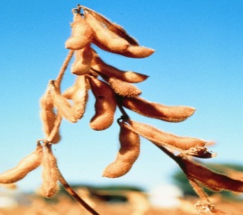
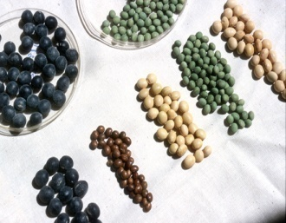
Farm Bill and Trade Aid Updates
Rod M. Rejesus
Professor and Extension Specialist
Dept. of Ag. and Resource Economics
NC State University

Slide 2
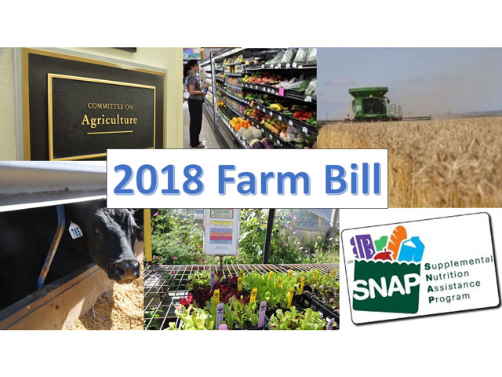
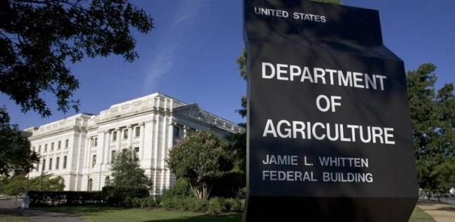
Goals for Today
Status of the “2018” Farm Bill
Discuss background and some issues
Trade Aid Updates
Focus on MFP payments

Slide 3
Farm Bill Updates
Congress have been working on the 2018 Farm Bill since last year (even earlier)
House version passed (barely) in May 2018
Senate version passed in June 2018
Conference proceedings started Sept. 5, 2018
But no agreement yet
2014 Farm Bill expired on Sept. 30, 2018
But passed Continuing Resolution to fund programs through Dec 2018 (i.e., another “crop year” expiration is Dec 31, 2018)
Notes:
House: Fail first (198-213) due to immigration issues; then 2nd vote (213-211) along partisan lines
Expiration is end of fiscal year (Sept 30) or with crop year (dec 31)

Slide 4
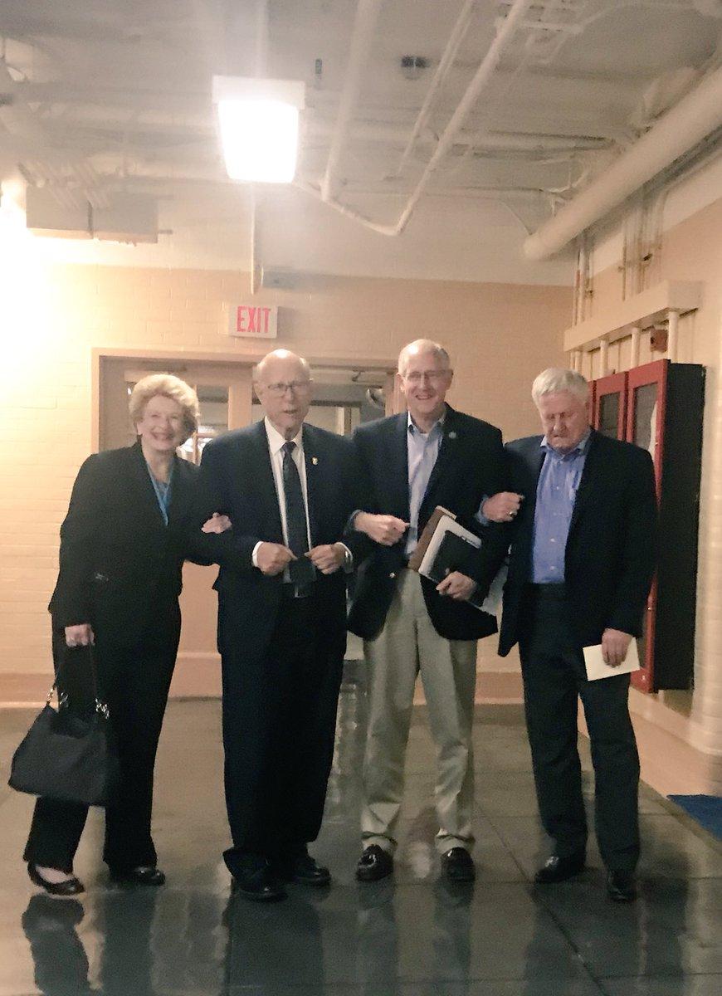
Farm Bill Updates
“Each of us is still at the negotiating table, and we remain committed to working together on a Farm Bill. Our conversations are productive, and progress toward an agreement is taking shape. We are going to get this right.”
Sen. Roberts (R-KS), Rep. Conaway
(R-TX), Sen. Stabenow (D-MI), Rep.
Peterson (D-MN) [Sept 26, 2018]

Slide 5
Farm Bill Updates
Points of contention (mainly from House version):
Work requirements for SNAP eligibility
20 hours per week work requirement for capable adults
Region-specific update of payment yields (for drought counties; mostly benefitting cotton producers)
Why not just nationwide?
Elimination of the Conservation Stewardship Program (CSP) & issues with related conservation programs
Merging CSP to EQIP (House) &/or reduce CSP acres (Senate)
Notes:
Region specific – only counties with exceptional drought for 20 or more weeks; also -- base acres in ARC/PLC that have not been planted to any covered commodity from 2009 to 2017 will be no longer eligible to receive payments from ARC or PLC (H.R. 2, §1112 (c), Engrossed in House). It is understood that this provision provides a budgetary offset for the increased spending in the House farm bill’s regionally-specific program yield update
SNAP -Provides that work capable adults (ages 18-59) work or participate in work training for 20 hours per week.
Conservatin – also allows other non-farm entities (irrigation districts) to compete for EQIP; also region specific affects incentives for conservation

Slide 6
Farm Bill Updates
What’s next?
Conference proceedings to reconvene after mid-term elections
Farm Bill can still be finalized in lame-duck session before Dec 31, 2018
If not finalized, Congress will need to extend 2014 Farm Bill
Or will revert to permanent law (1948 Farm Bill)
Notes:
Finish bill in the lame-duck session after election – compromises will need to be made on both sides
Lot of folks say just extend rather than o the house version! (use senate version as template and go from there).

Slide 7
Trade Aid Updates
US response to help farmers affected by trade dispute with China (i.e., retaliatory tariffs on ag)
Three-fold package (estimated at $12 billion):
Market Facilitation Program (MFP)
Direct payments to farmers
Food Purchase and Distribution Program
Purchase ag. commodities affected by tariffs
Agricultural Trade Promotion (ATP) Program
Cost-share assistance to access new export markets and promote trade
Notes:
1.3 billion to food purchas
200 million to ATP
Remaining will for MFP (with first round payment ~4.6 billion)

Slide 8
Market Facilitation Program
FSA-administered
Payments on 50% of 2018 production
Eligibility requirements:
Conservation compliance
AGI <$900k (average for 2014-2016)
Verifiable records
Payment limits:
$125k for eligible commodities
$125k for dairy and hogs
 | Payment rate | 50% Effective Payment rate
Corn | $0.01/bu | $0.005/bu
Cotton | $0.06/lb | $0.03/lb
Dairy* | $0.12/cwt* | $0.06/cwt*
Pork** | $8/head** | $4/head**
Sorghum | $0.86/bu | $0.43/bu
Soybeans | $1.65/bu | $0.825/bu
Wheat | $0.14/bu | $0.07/bu
Almonds | $0.03/lb | $0.015/lb
Cherry | $0.16/lb | $0.08/lb
* Historical production reported for MPP dairy
** Total no. of heads on any date between 7/15 - 8/15/18
Notes:
Shelled almonds and sweet cherry in particular added later
Payment limit (per person or legal entity)
NOTE: issues with payment rate – not exactly congruent with price declines. But USDA released method for calculatin rate based on expected export reductions due to tariffs (From trade model)

Slide 9
Market Facilitation Program
Estimated average payments for NC growers
Commodity | Effective Payment Rate ($/bu) | NC Yield (bu/ac)* | Estimated Ave. MFP payment ($/ac)
Corn | 0.005 | 117 | 0.58
Cotton | 0.03 | 804 | 24.12
Sorghum | 0.43 | 54.2 | 23.31
Soybeans | 0.825 | 36 | 29.70
Wheat | 0.07 | 57 | 3.99
*Estimated 2018 NC Yields from NASS crop production reports
Notes:
For Hog producers with 1000 heads – will get $4000 ($4/head x 1000)
For dairy producers that producer 34000 cwt will bet 2040 ($0.06/cwt x 34000)

Slide 10
Market Facilitation Program
Eligible farmers need to sign-up with FSA
Sign-up now open through. Jan 15, 2019 (after harvest)
In-person with FSA/USDA or online application
As of Oct. 4, 2018, 59,275 applications nationwide
Second MFP payment may also be provided
To be determined by USDA
Notes:
Estimated sign-ups based on Bloomberg news.

Slide 11
Take Home Message(s)
Farm Bill in a “holding pattern” right now
Several issues still need to be resolved in conference
Eligible growers should apply for MFP after harvest is complete
Help alleviate adverse impact of trade dispute on commodity prices & farmer’s bottomline

Slide 12
Thank you!
Questions?
Contact: Rod M. Rejesus, NC State University
Tel No. (919)513-4605
Email: rod_rejesus@ncsu.edu
Website:
Agricultural Policy and Farm Bill Extension Website at NC Dept. of Ag. & Resource Economics:
https://cals.ncsu.edu/are-extension/policy-and-regulation/agricultural-policy-and-farm-bill/

