Slide 1
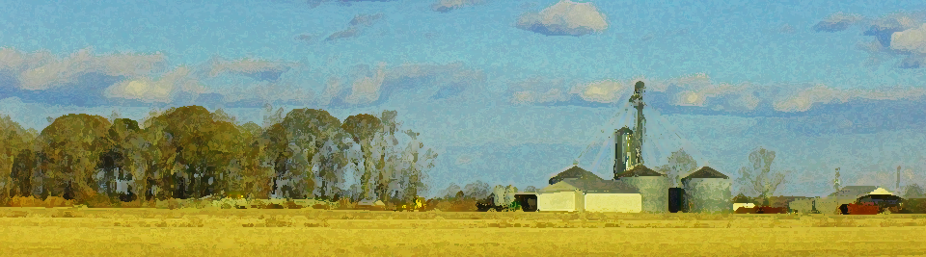
Planning the Future of Your Farm
Farm Transfer and
Related Legal Issues
Andrew Branan, JD
Assistant Extension Professor
Department of Agriculture and Resource Economics
North Carolina State University
rabrana2@ncsu.edu

Slide 2
Branan Program Update
On Campus Teaching ARE 309 Environmental Law
  Fall 2018 (T – Th) (p.m.) (less availability)
  Spring 2019 (M – W) (a.m.) (more availability)
2018 Programs
  Sandhills Farm Succession (with Paige Burns and Guido van der Hoeven)
    Printing of Planning the Future of Your Farm
    3 ’workshops’, multiple 1-1 conferences
    Funded by TTF
  Growers Legal Update (specific topics)
2019 Programs
  Land Summit (with LFPT)
  BFRDP Grazing Startups (with CEFS, Sarah Blacklin)

Slide 3
Voluntary Agricultural Districts Update
2018 Farm Act (amended NCGS
  Response to Smithfield nuisance suits
  County shall provide notification of ‘ag district’ or ‘qualified swine, poultry, or dairy’ farm
    GIS folks struggling to comply (presentation at Feb 2019 conf)
“Qualified Farm” means have signed an agreement
“Agricultural District” means whatever county says it is
Goal: Simplify lives of CES agents in coordinating role
Revise Model Ordinance
  Simplify ag district
  Streamline decision-making
Challenge: money, this will require some hours

Slide 4
Raw Milk is ”Legal”
Illegal to sell unpasteurized milk in NC except to “permitted hauler or regulated processor”
Farm Act of 2018
Amended N.C.G.S. §106-266.35 to add:
…“The term ‘sale’ or ‘sold’ does not include the transfer or dispensing of raw milk or raw milk products to, or the right to acquire raw milk or raw milk products by, the independent or partial owner of a cow, goat, or other lactating animal.”
Language points to single animal
  Issues include dry period, animal death, etc.
NCDA&CS does not have jurisdiction to issue rules

Slide 5
This Lawyer’s Experiences
Try not to give heirs undivided interests in land
  (without recorded options)
Don’t worry about the Estate and Gift Tax
  is ‘basis’ a concern?
All land dispositions must be in writing
Careful of PUV when planning land disposition
Succession is a framework filled with execution events
Create “survivorship” to reduce probate estate
One shot to develop a successor? (‘narrow window’)
When do you let go of “stuff”?

Slide 6
Consider Need to Keep Farm
“In the Family”
How did you acquire it?
  How many generations has it been “in the family”?
  Heirs often expect inheritance of a “purchased inheritance”
Does an heir require control of the land for their livelihood?
Is the land a current family gathering place?
  Reunion activity may not develop after you are gone

Slide 7
”Narrow Window”
Transfer of a going concern
Two projects in 2017-2018
  Both successors left the farm
  Transfer documents had ‘trap door’ for such
Is there time now to develop a new successor?
  Maybe not
  Shift to winding down, transferring leased land, planning for distribution

Slide 8
Durable Powers of Attorney (New Statute)
The NC Hot Powers are powers to
  Make a gift.
  Create or change rights of survivorship.
  Create or change a beneficiary designation.
  Delegate authority granted under the power of attorney.
  Waive the principal's right to be a beneficiary of a joint and survivor annuity,
  including a survivor benefit under a retirement plan.
  Exercise fiduciary powers that the principal has authority to delegate.
  Renounce or disclaim property, including a power of appointment.

Slide 9
Emerging Challenges with ”Land LLC”
Encountering a number drafted decades ago
Second generation of Members are “getting on”
Challenges
  No Operating Agreement = no buyout structure
  Voting quorum a challenge
  Contributions for land upkeep a challenge
  Lack of consensus to update or create Operating Agreement
  Lack of incentive to purchase ‘restricted shares
“Don’t want to pass on this mess to kids”
What is the endgame?

Slide 10
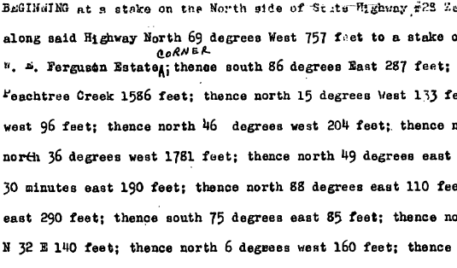
Real Property 101
Life Estate
  Life tenant pays taxes, collects rents, no “waste”
Tenancy in Common
  Undivided interest in entire parcel
Joint Tenancy with Rights of Survivorship
  Rarity in land
  Common with bank accounts and stock
Tenancy by the Entireties
  Property purchased during legal marriage
Severed Interests
  Timber
  Hunting
  farming

Slide 11
Preventing Partition
Tenant in common has right of partition land
  Actual Division (§46-1 et seq)
  Sale in Lieu of Partition (NCGS §46-22)
  Life tenant may partition timber (NCGS §46-25)
LLC Operating Agreement restricts partition
Beneficiary of Trust
  Limited to action against Trustee or Trust
Rights of First Refusal – maximum 30 years
  requirement to deal before partition
  Specific requirements (record Memorandum!)

Slide 12
Asset Protection: “I don’t want the nursing home to get my farm”
Difficult to plan for poverty
Medicaid Rules: Qualifying vs. Recovery (lien)
5 Year “Look-back” Rule
Uniform Fraudulent Transfer Act (existing debt)
NC – only probate assets (but including land) subject to recovery

Slide 13
Disposition by Gift
Gifting of Land
  Loss of right to rental/timber income
  Carry-over basis (potential higher capital gains)
  Exceed annual gift exclusion
  Survey Costs and Subdivision Process
Piece-Gifting of Equipment
  Bill of sale (non-titled equipment)
$15,000 annual exclusion
Lifetime gift exemption = $11,200,000 (2018)
  $22,400,000 for married

Slide 14
Disposition at Death: By Will
Will directs bequests (personal) and devises (real) property
Personal property listed in probate
Real Property not a probate asset (“drops like a stone”) (still listed required to pay debts)
Executor power to sell property (NCGS §32-26 & 32-27)
Tradeoffs:
Pros: Relatively lower cost, “deadline” to close estate, property distributed no strings attached, matter closed
Cons: Potential co-tenancy among disagreeable heirs, distribution to troubled heirs

Slide 15
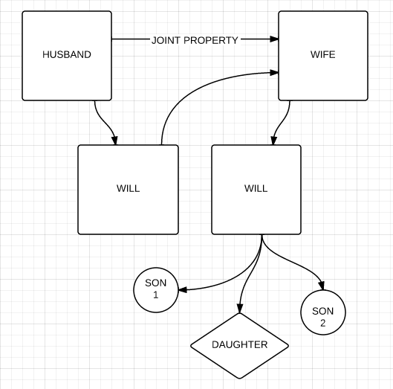
“All property to spouse”
“If predeceased by spouse, to children share and share alike per stirpes”
“...share and share alike”

Slide 16
Disposition by Trust
Use as “will-substitute” to direct bequests and devises
  Offers greater level of post-death administration
  Easier to amend
Use to Protect Certain beneficiaries
Separate or Joint?
  “It depends”
Use to step-up basis at death of first spouse

Slide 17
Types of Trusts
Testamentary Trust (in a will)
Revocable Trust
  Fund during lifetime (put in, take out)
  Fund through ‘pour over’ will
  Amend as needed
Irrevocable Trust
  Insurance Trust (ILIT)
  “Asset-Protection”
Special Needs Trust
Charitable Trusts
“Dynasty” Trusts

Slide 18
Trust Features for Farms/Forest
Protect land/farm interests, income to surviving spouse, use step-up basis flexibility
Consolidate personal property farm assets into entity or to “farming heir”
Specific property distributions (“Equal”)
Options to Capture Title (“Fair and Equal”)
  Options in favor of “farming heir” generally
Obligate Trustee to Lease Farm to farm heir
Allow Trustee to form LLC for land prior to distribution (Supply terms)

Slide 19
Assets to Place in Revocable Trust
Land interests
  Record deed
  File PUV application within 60 days
Business entity interests (land or operating)
  Use transfer of death certificates
Assets in Trust not listed in Probate inventory
Trust as insurance beneficiary

Slide 20
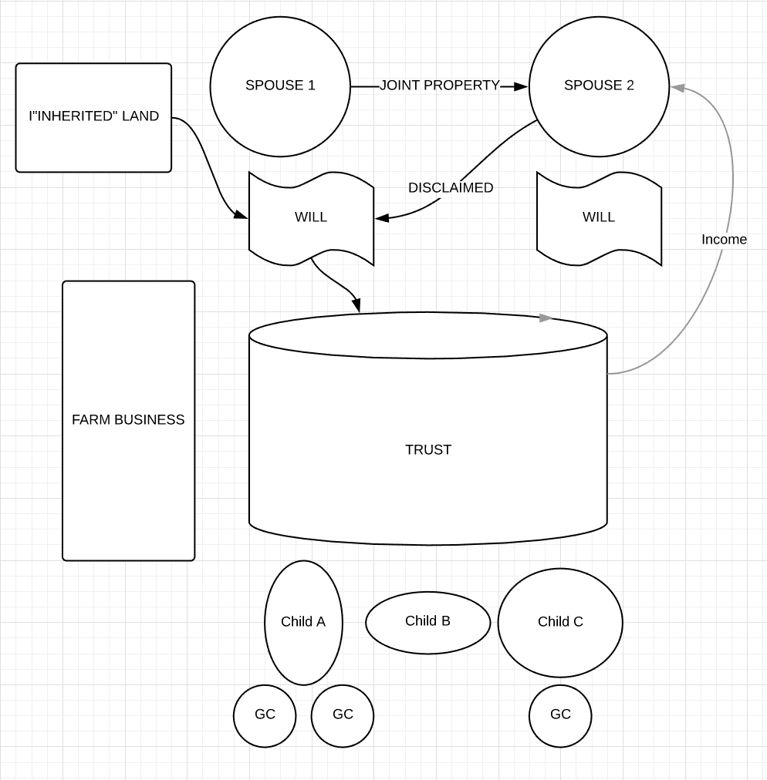

Slide 21
Trust Challenges/Opportunities
Trustee Succession
  Family “benches” sometimes not deep
  Trustee oversight (trust protector or court)
  Institutional trustee (need high liquid principal)
Protect farm assets from creditors or remarriage or “whims” of surviving spouse
Use of portability and disclaimer
Specific Power to Decant
  Power under state law (no good if Trustee is also Beneficiary)

Slide 22
Use of Business Entities
Liability protection (protect personal wealth, land)
Contract between owners
  Income
  Management
  Equity
Buy-Sell (Manage the D’s: Death, Disability, Divorce, Disaster, Disagreement, Disengagement)
Vehicle for reducing parents’ estate value
  Valuation discounts
  Organized gifting or sale program

Slide 23
The Operating Agreement
A Contract between contributors of assets
Restricts who can be members
  Member vs. Assignee
Dictates voting requirements for decisions
  Manager
  Voting and Non-voting Units
Dictates triggers for buy-sell
  Farming Heir Option to Purchase
  Who may buy and when
  Appraisal procedure
  Price and payment terms (seller finance option)
For existing S Corps, use Stock Purchase Agreement

Slide 24
Transfer of LLC Interests
Gift of Interest (measured in “units”)
  Calculate value of company
  Divide value by number of units to determine price per unit
  Transfer total units < $14,000 annual gift tax exclusion
Sale
  Purchase from Other Members or Trust
    Purchase with insurance proceeds under Buy-Sell Agreement (Designate beneficiary and agreement between all participants + spouses)
  Spread capital gain over term note
  Discounting of interest value
  Some relief from Self Employment taxes

Slide 25
LLC Set-Up Tasks
Sketch plan, get accountant and lender sign-off
Form entity with Secretary of State (after Jan 1)
Get EIN (tax ID)
Open bank account
Elect S form 2553? (save on payroll tax)
Re-title over-road equipment with DMV
Update Contracts (or record DBA’s)
Update FSA payment entities
For Land, update PUV within 60 days

Slide 26
About Farm Leases
Contract between farmer and landowner permitting farmer to access and use of the land
Can be written or verbal “handshake”
Annual Ag Tenancies protected under NC law (termination notice depends on county)
Process of drafting written agreement forms basis of understanding between landowner and farmer (risk management)
Decision to enforce lease = (Sunk Costs + Loss of Future Production) – cost and cash flow of legal action
Notes:
Let’s talk about leases for a second. Chances are, you are going to rent land before you buy land. Most farmland rental in North Carolina is done on a handshake, there’s no written agreement. The tenant follows normal farming practices that are customary in the area, and there’s not much to get in a fuss over because our state statute allows a farmer to collect his or her crops at the end of the season if the land is sold out from under them. You will be challenged to find some landowners willing to write out an agreement. This is fine but don’t count on being on that land for too long before they commit to a writing or even sale discussions.
Always remember that when renting land, you are just paying for access to it, you aren’t earning any equity. Without going into the ins or outs of leasing vs. purchasing, just know this equity in land you own will continue to help you with operating money as the years go by.
Take heart though that many newer landowners, baby-boomers that have inherited land or have bought it but aren’t going to farm it, they are looking for tenants to keep the land farmed and clear of trees, and in my experience seem more atuned to having a written agreement.
A written lease is a legally enforceable piece of paper that, if one of you breaks it, then the other has to make a decision how to enforce it. For the landowner it’s easier, they can just move to evict you and you have to argue to a court why you should stay. For you the farmer it’s harder: if a landowner breaks the lease (ie. won’t let you on the land), or if the land is sold, you have to make a decision whether it is worth the money to enforce the lease or walk away.
Either way, a written lease is the foundation of the agreement you the farmer reach with the landowner, and it goes very very far in mitigating the risk that there is going to be a disagreement between you.

Slide 27
More About Farm Leases
Cash rent or Share risk/expenses with landowner
Description of Land
  Address, PIN, deed reference
  Specify acreage (size of tract if whole farm)
Description and term of use
Use of buildings and materials
Amount of rent
Clarify any other expectations or obligations
  Require Tenant to provide Schedule F on annual basis
  Termination for lack of use/revenue generation
Three+ year leases must be recorded with county
Notes:
So a bit about the terms of the lease. The minimum needed to have an enforceable lease are 1) correct identity of the parties (remember you need to know the person you are dealing with has the authority to lease you the land, remember the slides back there on forms of ownership!), 2) the identity of the property you will have access to; 3) the term of the lease, and 4) how much you are going to pay for using the land.
Leases can be cash rent (where you just pay a specified amount either per acre or calculated for the whole farm), or they can be share leases, where the landowner takes some of the risk by helping provide certain inputs, and the payment they receive may be a combination of cash rent and a percentage of receipts.
As far as describing the land, specify the acreage, note the PIN, maybe even cite a deed book and page reference the property. If you are getting access to a certain portion of a larger tract or farm, you might attach a google earth image as a marked exhibit with the farmed area shaded in. Be sure you access is marked too.
It benefits you to keep the description of what you are farming as general as possible. The landowner may have certain land management expectations from you from peripheral areas, just make sure these are spelled out and given a value if possible.
Again, the biggest value of the lease is making it clear to would be purchasers that you have the rights to use the land for a certain time. To that end, leases in excess of 3 years must be recorded in the county deed office, otherwise they aren’t enforceable against another claimant.

Slide 28
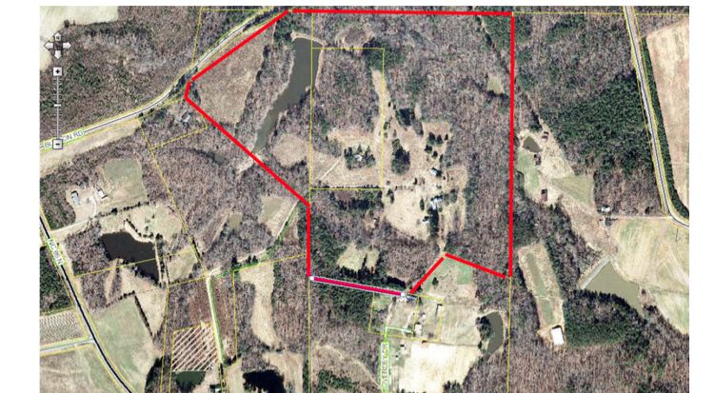
Exhibit (Farmstead Area)

Slide 29
Hunting Lease Overview
Description of Property
  PIN, common name
  Acreage
  Exhibit areal photo of ’no hunting’ zones
Term (e.g. April 1 through March 31)
  Auto renewal? NEVER
Hunting clubs
  Copy of member rules
  Incorporate violation as default
Deer blinds and structures
Liability Insurance?
Require carry club membership card and card permission form (attach to lease as Exhibit)

Slide 30
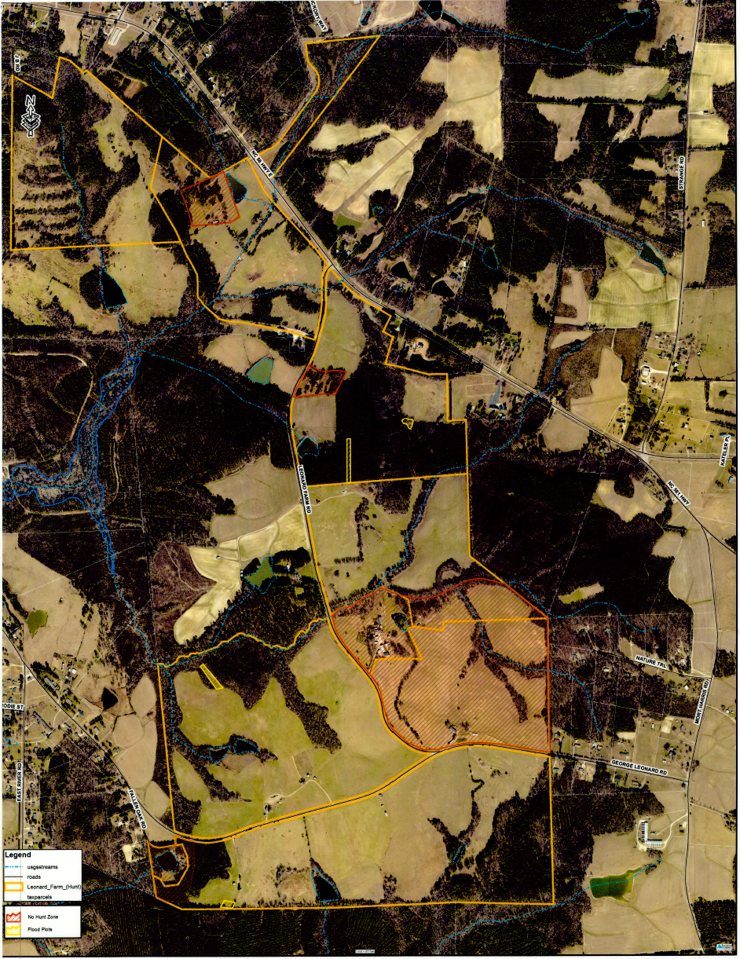
Exhibit

Slide 31
Trespass Generally
§38B-2. General rule. A possessor of land, including an owner, lessee, or other occupant, does not owe a duty of care to a trespasser and is not subject to liability for any injury to a trespasser.
§38B-3. Exceptions
  Intentional harm = “willful or wanton”
    Example: thin wire across field entrance (to repel ATV)
    May use reasonable force to repel a crime
  Harm to Children (<14) (attractive nuisance doctrine)
    reason to know that children were likely to trespass and
    owner knew of unreasonable risk of serious bodily injury or death and
    child did not appreciate the risk and
    utility to the possessor of maintaining the condition and the burden of eliminating the danger were slight as compared with the risk discover the condition or realize the risk involved and
    possessor failed to exercise reasonable care to eliminate the danger or otherwise protect the injured child.

Slide 32
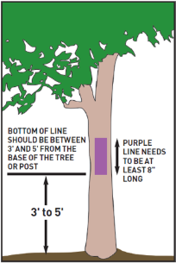
Landowner Protection Act
Prior to 2011, WRC had to get warrant to arrest trespasser
NCGS §14-159.6 (outlines proof of permission)
  Class 2 Misdemeanor for “willful” trespass
  Class 1 Misdemeanor for pine straw trespass
  Must produce written permission when confronted by Wildlife Resources Commission officer or sheriff/deputy sheriff
  HUNT CLUB
    Must produce hunt club membership card, and
    Written permission
NCGS §14-159.7 (marking)
  Signs not less than 120 square inches
  Not more than 200 yards apart
  May paint Purple Mark
    Vertical line 8 inches long
    3 feet above ground
    100 yards apart
Source: NC WRC

Slide 33
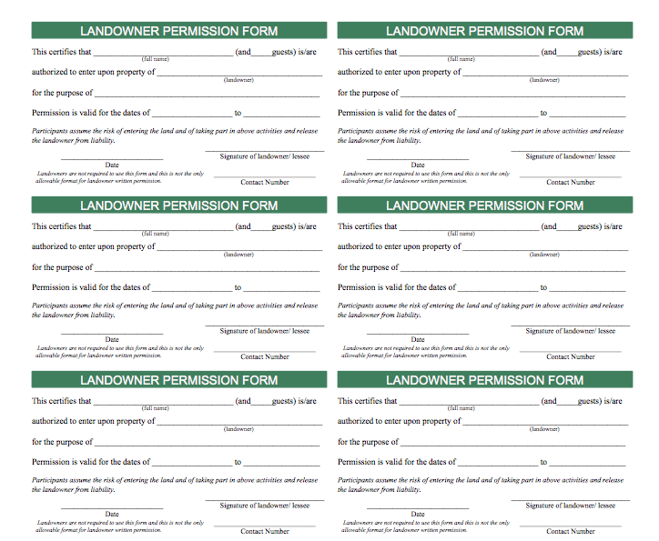
Wallet Size Card

Slide 34
Timber Trespass
N.C.G.S.§14-128. Willfull injury to trees is Class 1 Misdemeanor
  NCDOT gets pass in RW
NCGS §1-539.1
  Injured landowner entitled to double stumpage of timber cut (cutting and burning)
  Need a good boundary survey (mark boundary trees)
  Timber harvester entitled to reimbursement from landowner who misrepresents property lines
Hamby v. Thurman Timber Company (July 2018)
  Contractor trespass not attributable to buyer (without more evidence)

Slide 35
THANKS FOR INVITING ME!
Robert “Andrew” Branan
Assistant Extension Professor
Department of Agriculture and Resource Economics
North Carolina State University
Campus Box 8109
4336 Nelson Hall
Raleigh, NC 27695
rabrana2@ncsu.edu
919 515 4670

