Slide 1
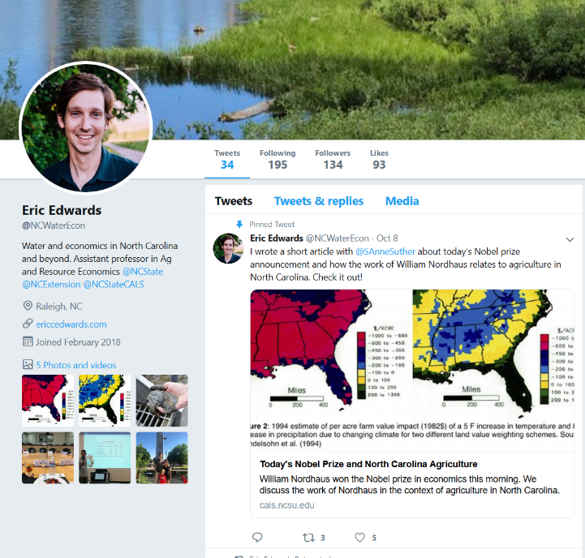
Water Resource Economics @NC State
Research | Teaching | Outreach
Water in Agriculture
  Water table management
Water Quality
  Low-cost abatement
Climate Change
  Adaptation; irrigation
Water Conservation
  Price → behavior
email: eric.edwards@ncsu.edu
website: www.ericcedwards.com
twitter: @NCWaterEcon

